Slide 1

Bloodborne Pathogens

Slide 2
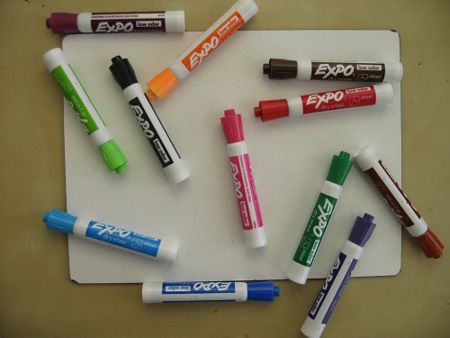

Topics to cover
Why are we here?
What are bloodborne pathogens?
Overview of bloodborne diseases
How bloodborne pathogens are transmitted
Preventing exposure
Process for cleaning up contaminated waste
Hepatitis B Vaccination
Quiz

Slide 3
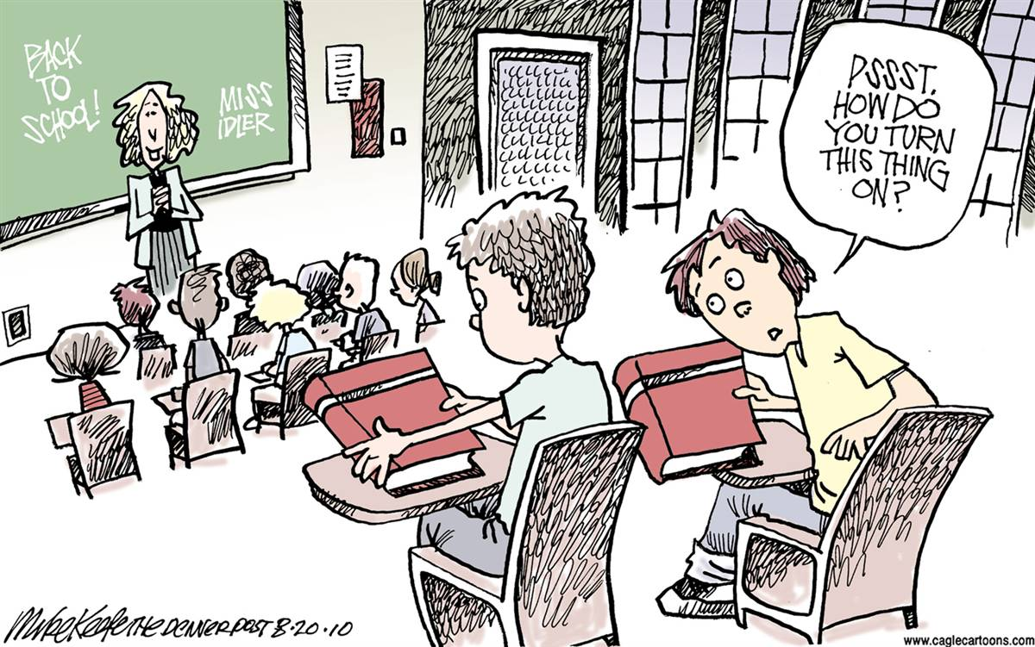
Why are we here? WAC 296-823-12005
This training is required initially and annually for affected staff & faculty
Notes:
This training is required initially and annually for affected school staff and faculty, you are taking this training because you are an employee who could have an occupational exposure to bloodborne pathogens due to your current position
Instruct staff and faculty on ways to protect yourself from occupational exposure to bloodborne pathogens.

Slide 4
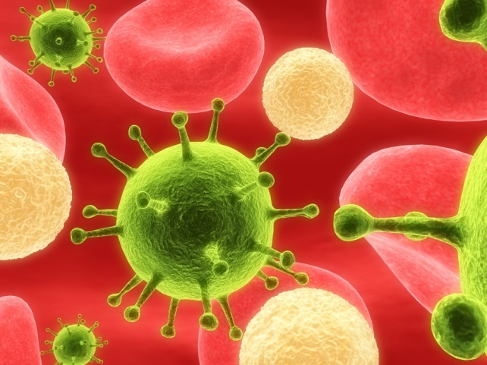
What are Bloodborne Pathogens?
Micro organisms carried in the blood
Main disease concerns for training:
  Hepatitis B
  Hepatitis C
  HIV (AIDS)
Notes:
Bloodborne pathogens are organisms, such as viruses and bacteria, that are carried in human blood. These organisms can cause illness, and in some cases eventual death. The bloodborne pathogens of primary concern that we are going to talk about today are Hepatitis B, Hepatitis C, and HIV/AIDS.

Slide 5
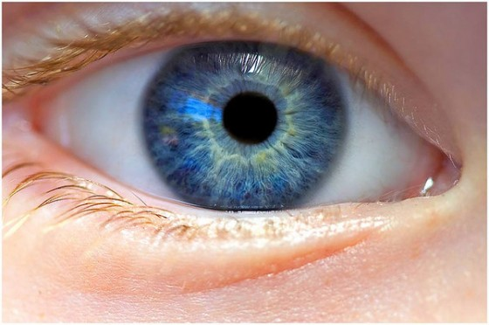

Ways Bloodborne Pathogens Can be Transmitted…
A break in the skin (cut, lesion, etc.).
Mucus membranes (eyes, nose, mouth).
Sexual contact.
Other modes.
Notes:
There are various ways that bloodborne pathogens can be transmitted-
A cut, lesion, break in the skin
Through the mucus membranes
Sexual contact
etc

Slide 6
(Risk for Exposure)Other Potential Infectious Materials…
Blood
Semen
Vaginal Secretions
Breast Milk
Saliva
Vomit
Feces
Urine
Notes:
There are other potentially infectious materials, which are any body fluids containing or suspected of containing blood (which could be the following):

Slide 7
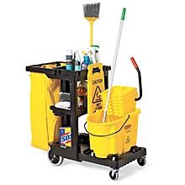


Workplaces Where BBP Exposures May Exist
Hospitals and medical clinics
Nursing homes
Dental offices
Paramedics
Law Enforcement
Housekeeping
Prisons
Hospitality Industry
Notes:
Here are examples of workplaces where exposures to bloodborne pathogens may exist…

Slide 8
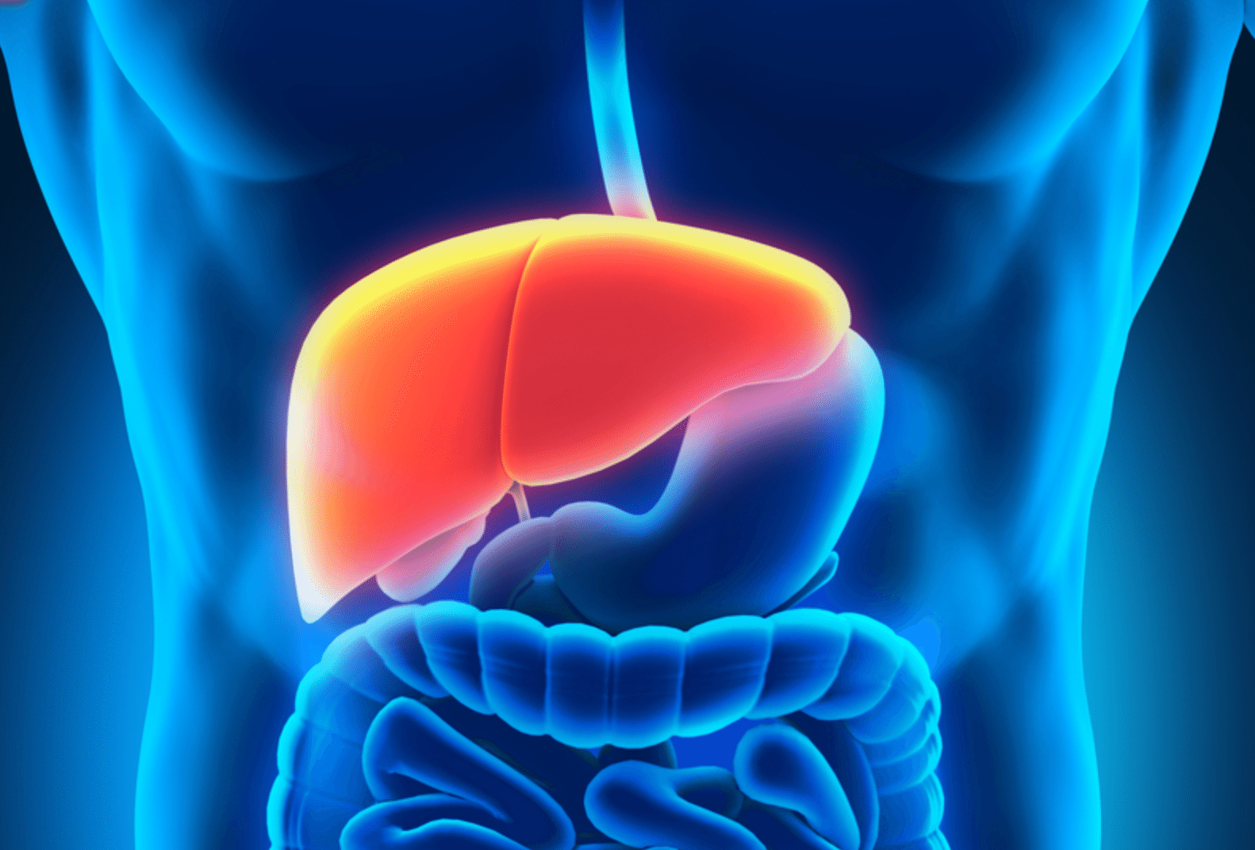
Hepatitis & the Liver
The liver is a vital organ of your body
Hepatitis infects the liver
Notes:
Liver is a vital organ of your body- the main function of the liver is to filter the blood coming from the digestive tract, before passing it to the rest of the body.
Hepatitis is inflammation of the liver. Hepatitis can lead to scarring of the liver, and regulating the flow of blood.

Slide 9
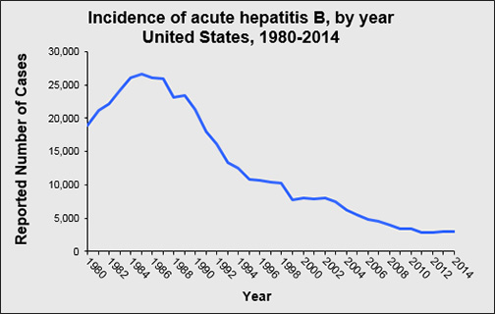
Hepatitis B
Over 12 million Americans infected (1 out of 20)
Can survive at least one week within dried blood
Silent infection, silent killer
Vaccination is available
Symptoms
Notes:
Hepatitis B can lead to cirrhosis of the liver, or/and liver cancer
Hepatitis B is very hearty, it an survive at least 7 days within dried blood
Some symptoms of hepatitis B: Fever, fatigue, loss of appetite, jaundice, joint pain, nausea, etc.

Slide 10
Ways Hepatitis B is Transmitted…
Sex with an infected partner
Injection- drug use
Birth by infected mother
Contact with blood, or open sores
Needle sticks
Sharing items (razors or toothbrushes)

Slide 11
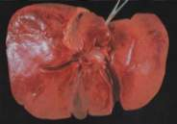
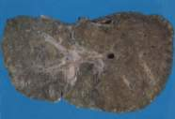
Hepatitis C
Symptoms- similar to hepatitis b symptoms
No vaccine available
Common cause of liver transplantation in the U.S.
Can lead to chronic liver disease or death
Cure is available
Copyright 1998 Trustees of Dartmouth College
Healthy human liver
Hepatitis C liver

Slide 12
Ways Hepatitis C is Transmitted…
Injection use
Receipt of donated blood
Needle stick injuries in health care industry
Notes:
Hepatitis C is transmitted primarily through parenteral exposures through infectious blood or body fluids- exposures include:
Injection drug use
Needlestick injuries
Receipt of donated blood
Birth by hepatitis c infected mother

Slide 13
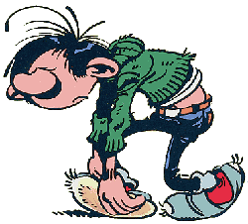
Hepatitis A
Highly contagious liver infection
Self limited disease
Symptoms: Fatigue, low appetite, nausea, jaundice
It can survive outside the body for months

Slide 14

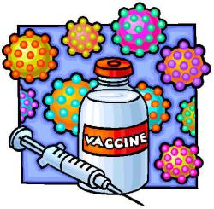
How is Hepatitis A transmitted?
Hepatitis A is usually spread when a person unknowingly ingests the virus from objects, food, or drinks contaminated by small, undetected amounts of stool from an infected person.
Close personal contact with an infected person, such as caring for someone who’s ill, or through sex.
VACCINE AVAILABLE

Slide 15
Similarities & Differences- Hepatitis A, B & C
Similarities- Both hepatitis b and c cause short and long term effects.
Hepatitis A- usually short term infection
Differences- Hepatitis B can be transmitted through bodily fluids, while usually hepatitis c occurs through blood-to-blood contact
There is a vaccine for Hepatitis A & Hepatitis B

Slide 16
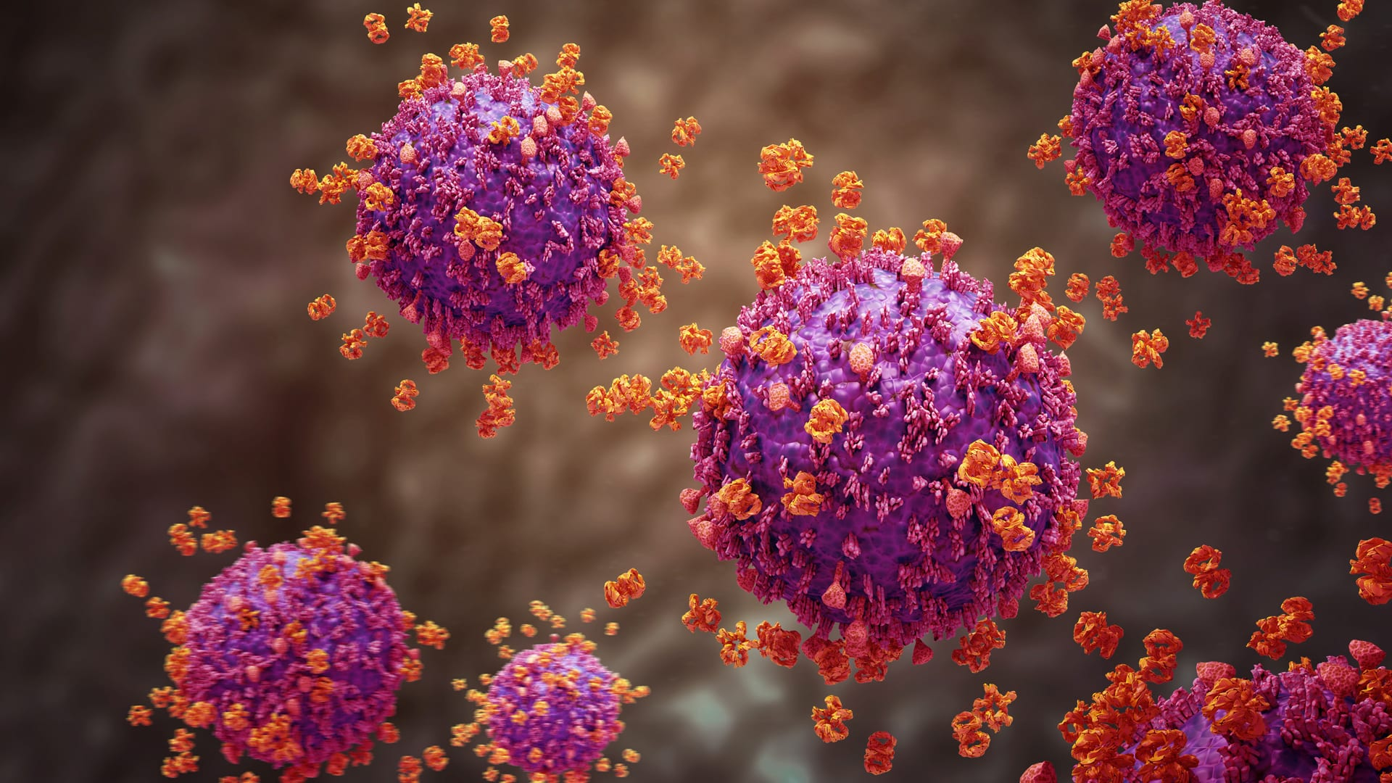
HIV (Human Immunodeficiency Virus)
History of HIV
HIV attacks the immune system
HIV is the cause of AIDS
Fragile- only survives a few hours in a dry environment, does not transmit through the air
No effective cure thus far- however, with proper medical care HIV can be controlled
Notes:
HIV attacks your body’s ability to protect itself from disease. It destroys the human immune system by attacking certain cells known as T cells, which are part of the first line of defense that our immune system has to fight infection.

Slide 17
Ways HIV is Transmitted…
Practicing unsafe sex with someone that has HIV
Sharing needles or syringes

Slide 18
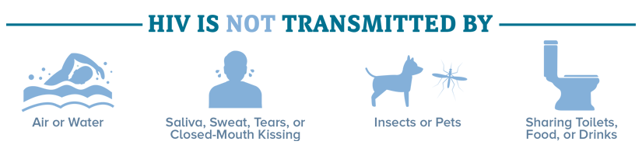
Myths regarding HIV

Slide 19

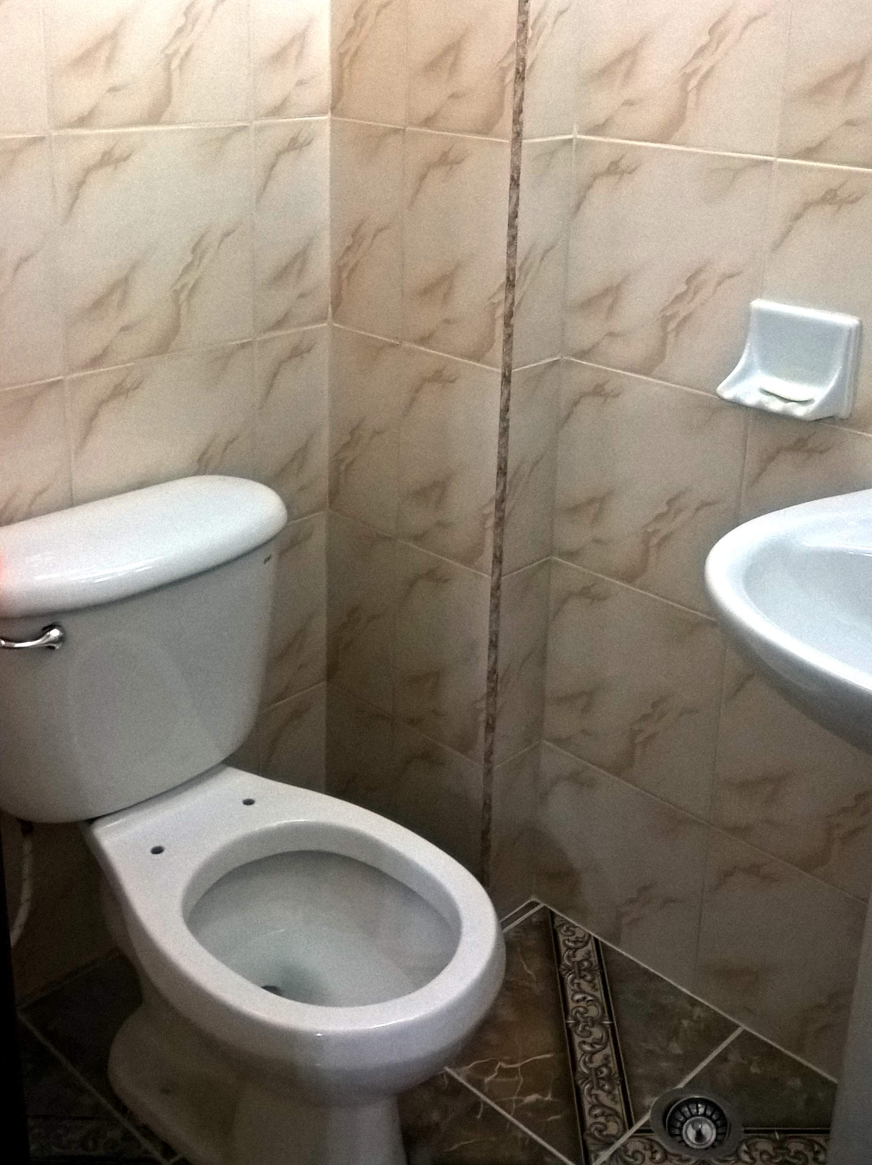


Bloodborne Pathogens Are Not Transmitted By…
Coughing
Eating Utensils
Drinking Fountains
Toilet Seats

Slide 20

What is your employee’s responsibility in preventing employee exposures to BBP’s?
Exposure Control Plan
  Exposure determination
  Exposure Controls
  Training
  Hepatitis B Vaccination
  Post-Exposure Evaluation & Follow-Up
  Recordkeeping
Notes:
The Exposure Control Plan is designed to eliminate or minimize your risk of exposure to BBPs at work. It includes our policies and procedures, and also identifies persons or departments with specific responsibilities
Briefly, the Exposure Control Plan contains the following elements:
An exposure determination to identify employees who are at risk for exposure
The methods and controls we use to protect you from exposure to bloodborne pathogens
Training and Hazard Communication requirements
Post-exposure evaluation and follow-up procedures if you experience an exposure incident
Record keeping, including documentation of any occupational exposure incidents

Slide 21
Exposure Determination (Job Classifications to have Potential Exposure:
  Facilities Services Building Specialists who cleanup blood or OPIM
  Biology Storeroom staff who receive/sterilize infectious materials
  Sports Medicine and Training staff and faculty who may respond to injuries or provide treatment
  Security Services staff who are First Aid/CPR/AED responders
  Counseling Health and Wellness staff/faculty who provide patient care and treatment
  Physical Therapy staff/faculty who handle blood and OPIM

Slide 22

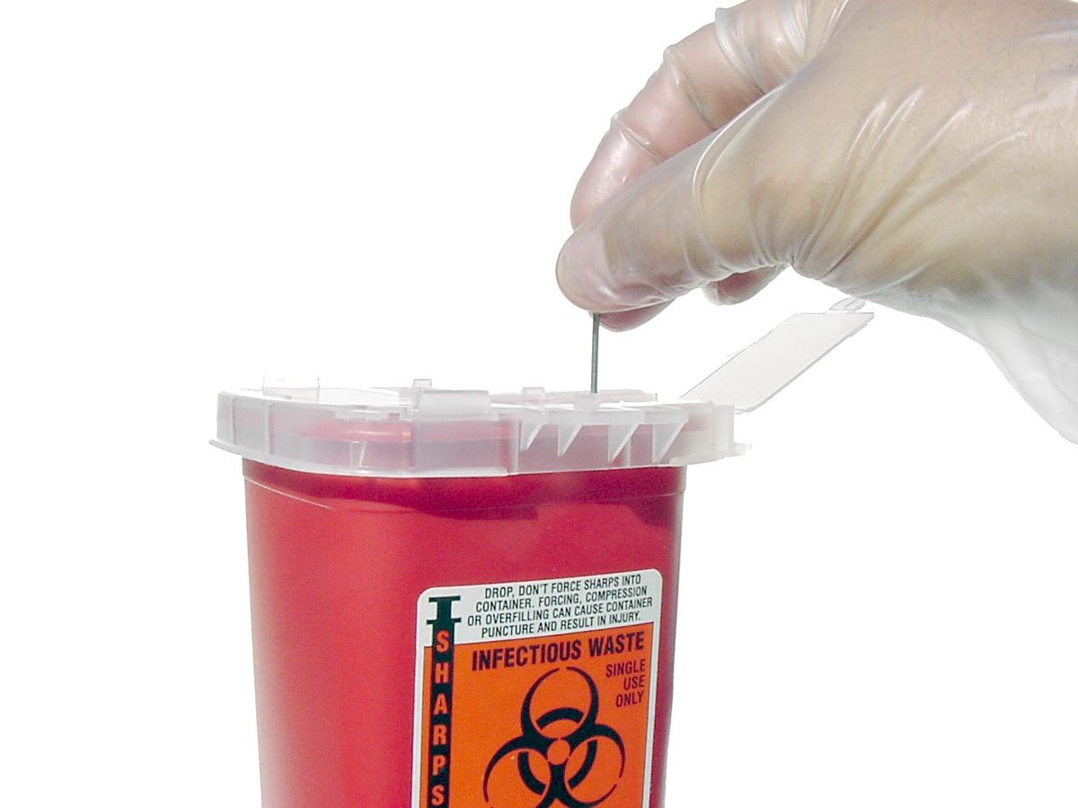
Exposure Controls
(Reducing Your Risk)
Use universal precautions- treat all blood and bodily fluid as if its contaminated
Training
Wear proper PPE
Housekeeping
Hepatitis B Vaccination
Notes:
The risk of occupational exposure to BBPs can be reduced or prevented by these methods, which we will discuss further:
following universal/standard precautions- treat all blood or body fluid as if its contaminated
using safer medical devices and equipment
following proper and safe workplace policies, practices, and procedures
using appropriate PPE when contact with blood or OPIM is expected
maintaining a clean workplace
making sure all contaminated materials are properly labeled

Slide 23
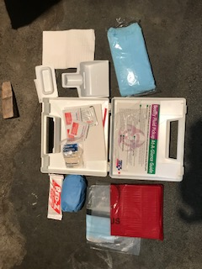
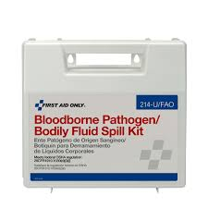
PPE
You must wear all PPE
We provide the PPE for you at no cost
Bloodborne Pathogen Bodily Fluid Spill Kits-Located in all main custodial closets (room numbers are in Exposure Control Plan)
Notes:
When equipment, safer devices, and safe work practices do not eliminate exposure, the use of personal protective equipment, or PPE, is required. PPE that is “appropriate” will not permit blood or other OPIM to pass through or reach your clothes, skin, eyes, mouth, or other mucous membranes.

Slide 24
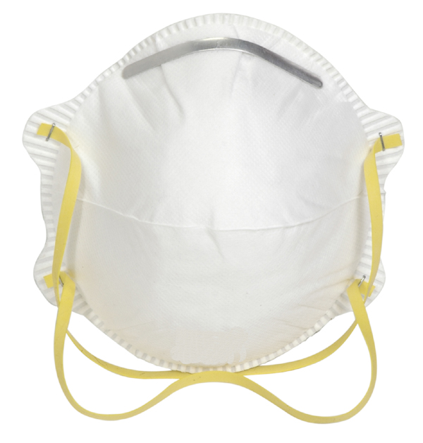
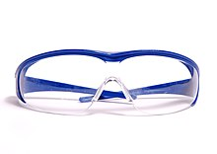
Exposure Controls – Wear Proper PPE
Eye Face Protection & Masks
Notes:
Wear appropriate face and eye protection when splashes, sprays, spatters, or droplets of blood or OPIM pose a hazard to the eye, nose, or mouth.
Face shields would be needed if the risk and amount of potential splash or splatter to the face is substantial. The skin as well as the eyes needs to be protected.
If the risk of splash is minimal, glasses with side shields might be adequate.
Splash goggles or the use of a mask in combination with an eye protection device may be required in higher risk situations.

Slide 25
How To Clean Up Exposure
Put on all proper PPE prior to cleaning area
If the area isn’t cordoned off already, place caution tape around perimeter of area to deter people from area of potential infectious materials
Spray biohazard with hospital grade disinfectant, let it sit on blood for at least 10 minutes
Place absorbent towels onto blood, spray another layer of disinfectant until it soaks through.
use brush and mini dust pan to pick up blood
Place in red biohazard bag , dispose of properly (send to Harned 249 autoclave)
Thoroughly wash hands after exposure clean up
Notes:
Create a video as to how to clean up exposure

Slide 26
Demonstration of Clean Up:
https://www.youtube.com/watch?v=wURSIrKaNiw&list=PL5890B0ACB55785E7&index=12

Slide 27
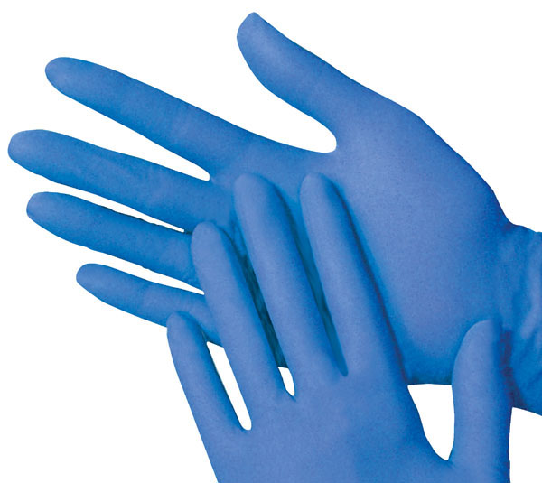
How to Properly Remove Gloves
https://www.youtube.com/watch?v=S4gyNAsPCbU

Slide 28
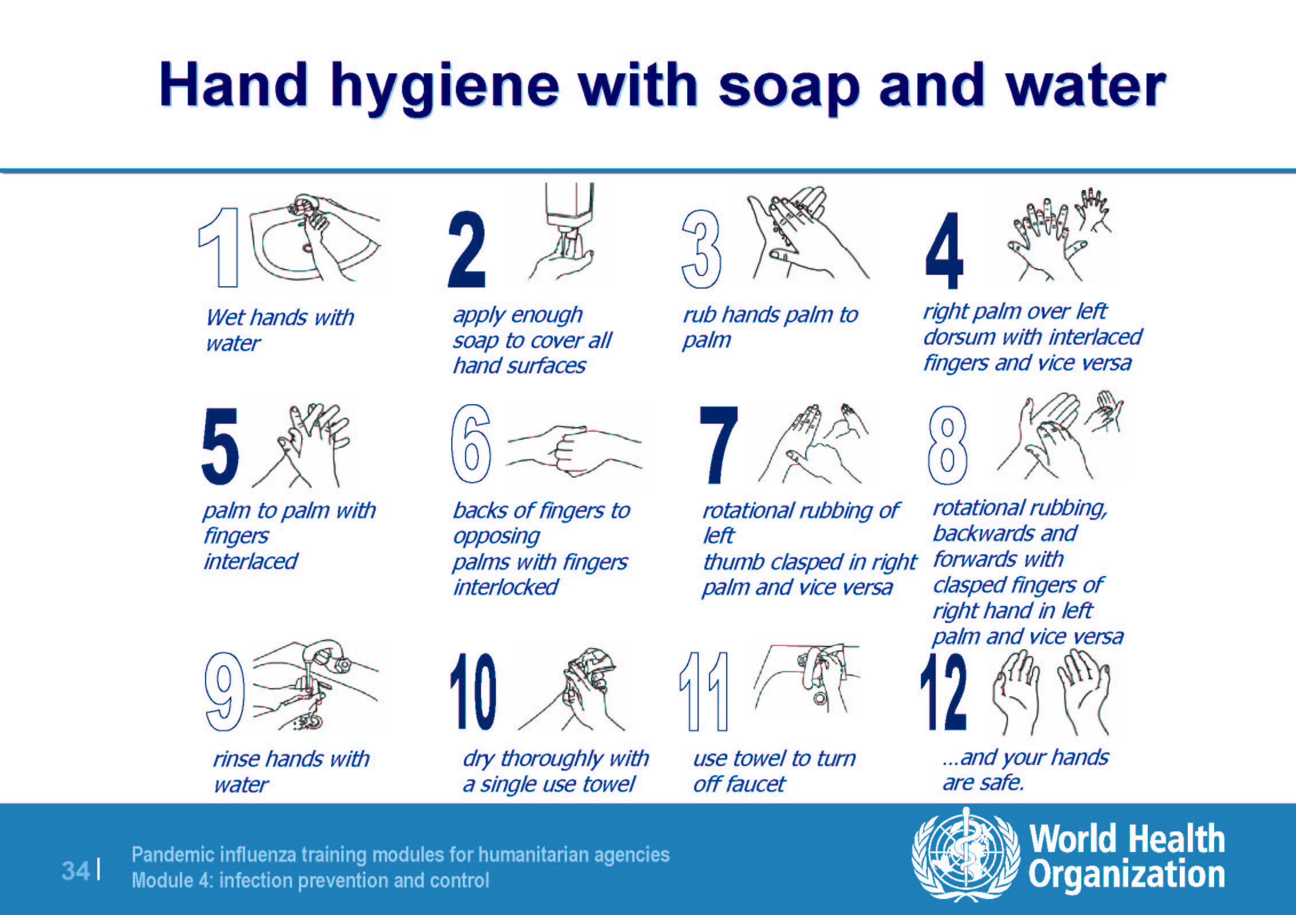
Washing Hands
Notes:
Washing your hands immediately after glove use is imperative.

Slide 29
What to do with contaminated clothing?
Please place in red biohazard bag, and take to Harned 249 to be autoclaved.

Slide 30
Exposure Controls
  Wear protective eyewear and mask, if splashing is anticipated.
  Remove glass and other sharps materials using a brush and dust pan, forceps, hemostat, etc. Do not use your hands.
  Properly discard all materials into a sharps or puncture-resistant biohazardous waste container.
  Use paper/absorbent towels to soak up the spilled materials.

Slide 31
Exposure Controls- Sharps Containers
Closable
Leak-proof
Puncture-resistant
Labeled, or color-coated
Upright

Slide 32
Hepatitis B Vaccination Series
3 shot series available at no cost to you
Shots are 0, 1, 6 months apart
Available via walk in at our Occupational Medical Clinic
Declination form available

Slide 33
What if there’s an Exposure Incident?
If you have an exposure to blood or OPIM, please immediately do the following:
  Thoroughly clean the affected area
  Wash wound with soap and water
  Report exposure to supervisor , and fill out incident report form
  You will be sent out for a post exposure evaluation

Slide 34
Post Exposure Evaluation the University’s Responsibility
Provide immediate post-exposure medical evaluation , and follow up with employee
  Scheduled as soon as possible post-incident
  Confidential!
  No cost to the employee
  Recordkeeping kept for length of employment plus 30 years.
  Health care professional’s written opinion on the post-exposure evaluation will be provided to you within 15 days of the completion of the evaluation

Slide 35

Bloodborne Pathogens Quiz

Slide 36
1. Bloodborne pathogens are:
Harmless germs
Dangerous germs that live everywhere
Microorganisms carried through blood
None of the above

Slide 37

That’s Correct!
Continue to the next question

Slide 38

Oops, that’s wrong…
Try again
Move on to the next question

Slide 39
2. Universal precautions mean to:
Treat all fluids as if they are contaminated
Wear gloves only when people look ill
Only be concerned about blood being contaminated
Wear googles at all times

Slide 40
That’s Correct!
Continue to the next question

Slide 41
Oops, that’s wrong…
Try again
Move on to the next question

Slide 42
3. Each employer should have an __________ to control occupational exposure of the University employees to bloodborne pathogens
Sickness response plan
Bloodborne pathogen exposure control plan
Infection control plan
None of the above

Slide 43
That’s Correct!
Continue to the next question

Slide 44
Oops, that’s wrong…
Try again
Move on to the next question

Slide 45
4. Bloodborne pathogen training is required…
Initially and annually
Monthly
Quarterly
Not required

Slide 46
That’s Correct!
Continue to the next question

Slide 47
Oops, that’s wrong…
Try again
Move on to the next question

Slide 48
5. “Hepatitis” is inflammation of what?
The brain
The liver
The heart
The pancreas

Slide 49
That’s Correct!
Continue to the next question

Slide 50
Oops, that’s wrong…
Try again
Move on to the next question

Slide 51
6. How often should the exposure control plan be reviewed/revised?
Monthly
Quarterly
Whenever a policy changes
Annually

Slide 52
That’s Correct!
Continue to the next question

Slide 53
Oops, that’s wrong…
Try again
Move on to the next question

Slide 54
7. Which of the following infections can be prevented with a vaccine?
HIV
Hepatitis A
Hepatitis B
Hepatitis C

Slide 55
That’s Correct! Both Hepatitis A and Hepatitis B have a vaccine
Continue to the next question

Slide 56
Oops, that’s wrong…
Try again
Move on to the next question

Slide 57
8.Which of the following is not considered OPIM?
Blood
Tears
Body fluids containing blood
Semen

Slide 58
That’s Correct!
Continue

Slide 59
Oops, that’s wrong…
Try again

Slide 60

Well done!
Any follow up questions, please feel free to send me an email:
znavarrete@pugetsound.edu
Facilities Help Desk: 253-879-3713
Thanks for your time!

