Slide 1
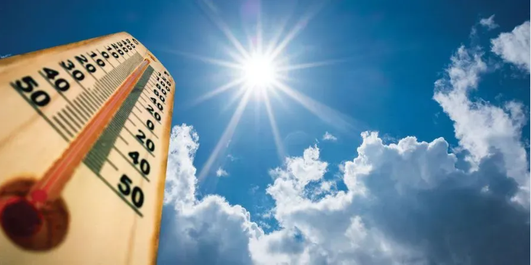
Outdoor Heat Exposure
Preventing Heat-Related Illness
Updated to meet June 1, 2022 emergency rule requirements
Notes:
The department of Labor & Industries (L&I) has a regulation on outdoor heat exposure that requires us to train all workers who may have to work outdoors in hot weather during the months of May through September every year. That includes workers in construction, logging, landscaping and agriculture working outdoors for more than 15 minutes in every hour. This rule does not apply to hot conditions indoors or to construction work when the work is done inside a structure with walls and a roof. It also does not apply to workers who are driving vehicles with air-conditioned cabs. This training is meant for both agriculture and non-agriculture workers.

Slide 2
First, let’s see what you would do. It’s a hot day. You are sweating a lot, and start feeling tired and dizzy. Select one.
1. Tough it out and
keep working.
2. Take a break, sit down
and drink water.
3. Keep working,
but take it easy.
Notes:
Let attendees choose and share why they think that is the response. 2. is the best answer.

Slide 3

Topics Covered
Temperatures this rule applies to
Factors that contribute to heat related illnesses
Signs and symptoms of heat illnesses, and how to respond
Actions you can take to prevent heat illnesses
Updates from the temporary Emergency Outdoor Heat Exposure rule effective June 15, 2022 through the end of September
Notes:
The goal of this training is to prevent heat-related illness and related injuries.

Slide 4
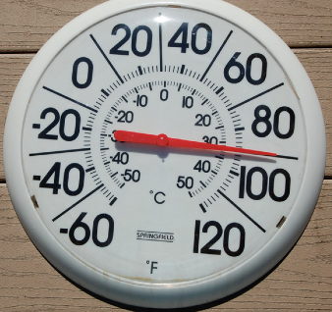
Why care about hot weather?
Excessive heat can send you to the hospital or even kill you
Deaths:
Experienced Farm Laborer - cutting weeds in temperature over 100 degrees
Construction worker - laying water pipes when the temperature rose to over 100°F.
Photo by Tom Magliery in Creative Commons
Workers hospitalized in Washington state:
Nursery worker working in 90 degree heat in the sun, treated for salt depletion
Temporary construction worker working in hot temperatures, treated for kidney injury
Notes:
Heat waves are predicted to happen more often and last longer due to our changing climate. During a heat wave between June 26 and July 2, 2021 there were 95 heat-related deaths in Washington State. However, heat related deaths are often under reported.
In 2018, two workers were hospitalized in Washington due to heat related illnesses. Heat stroke can cause brain damage or other internal organ damage, sometimes severe enough to cause death.
Heat affects you physically and mentally and can lead to other incidents such as collisions, trips and falls due to fatigue, or slow reaction.
[Ask your audience what other incidents could be related to heat. Let them share a story of heat-related incidents they know about or experienced.]

Slide 5
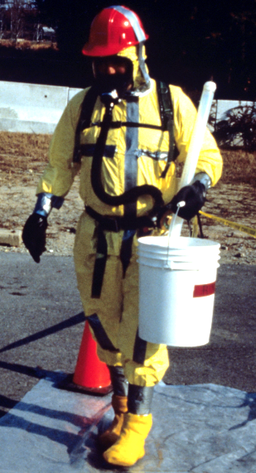
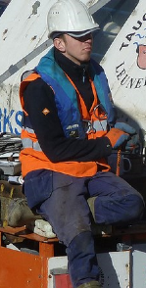
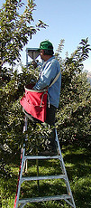
When is it too hot – what does the L&I outdoor heat rule say?
52°F – when wearing non-breathing clothing such as vapor barrier suits, chemical resistant suits and some rain gear.
77°F – when wearing double layer woven clothing such as sweatshirts, coveralls and jackets over shirt.
89°F – when wearing all other clothing. Typical clothes such as shirts and pants.
photo from NIOSH
Photo by Frank Rafik in Creative Commons
Photo by PNASH0
52°F
77°F
89°F
Notes:
At the temperatures shown here, we are required to take steps to protect you getting sick from overheating. The low temperature for non-breathing clothing is because little or no evaporation from sweating can happen and you will feel like you are in a sauna at temperatures above 52 degrees. At 89 degrees or hotter, heat illness can occur regardless of what you are wearing. Doing physically work in 89 degree heat or above, over time without adequate rest, water and shade will likely lead to heat illness in most people.

Slide 6
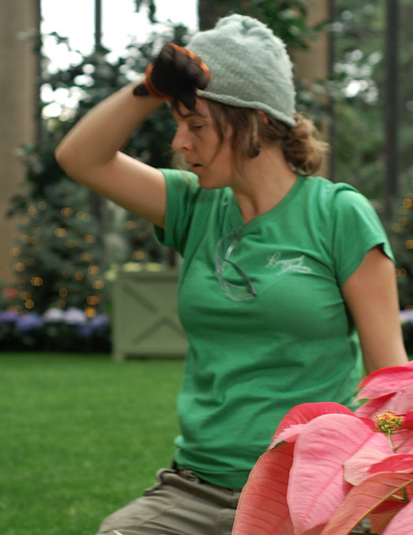
Heat-Related Illnesses
  Occurs when the body can’t cool off and overheats.
  This is caused by a combination of external and personal factors.
Photo by John Flinchbaugh in Creative Commons
Notes:
Heat-related illness (sometimes called heat stress) happens when the body can’t cool off enough to maintain its normal temperature. The environment doesn’t need to be extremely hot. We can get a heat-related illness from an increase in the body’s temperature such as during physical work in warm conditions.

Slide 7
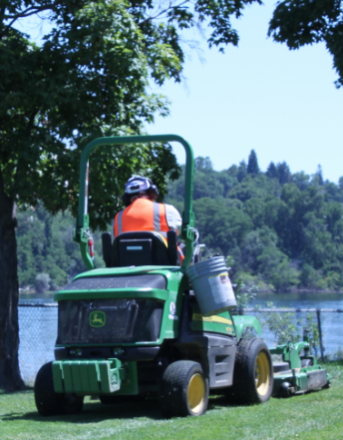
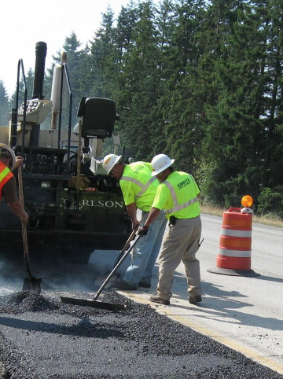
Factors Increasing Your Chances for Heat Illnesses
High temperature.
High humidity
No breeze.
Direct sunlight
Other heat sources around you.
Direct sunlight
Pavement and engines
Photos from L&I
Notes:
High temperature, high humidity, low wind or no breeze at all, direct sunlight, and being around hot surfaces such as the road, a roof, or engines can increase your chances for heat illnesses.

Slide 8
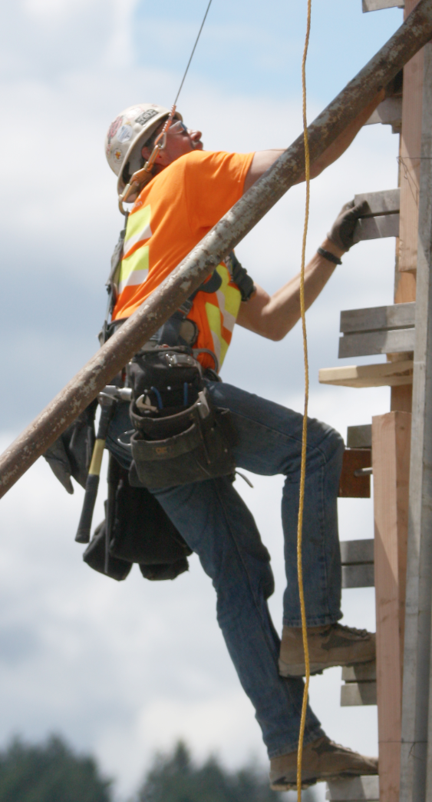
Factors Increasing Your Chances for Heat Illness
(continued)
Use of personal protective equipment
Clothing worn:
  Heavy
  Multiple layers
  Dark colored
  Tight-fitting
Physical effort, work.
Not being used to the heat.
Photo from L&II
Notes:
Not being used to the working conditions, doing physical work, and wearing clothes or personal protective equipment that retain heat increase your chances for heat illnesses.
Your body produces more heat the harder physical work you do. When you wear multiple layers of clothing or non-breathable clothing it is more difficult for your body to cool down, for sweat to dry, and for cooler air to reach your skin.

Slide 9
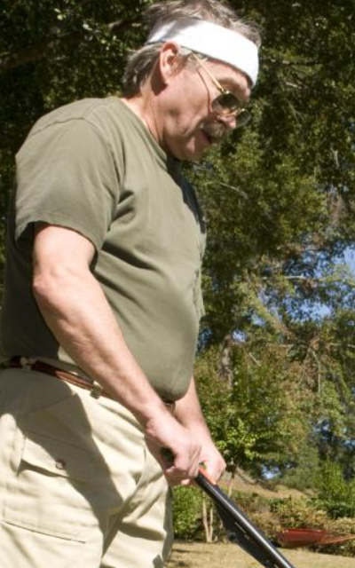
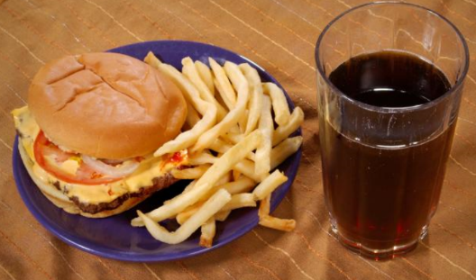
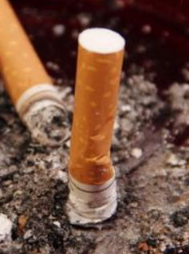
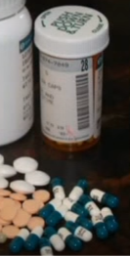
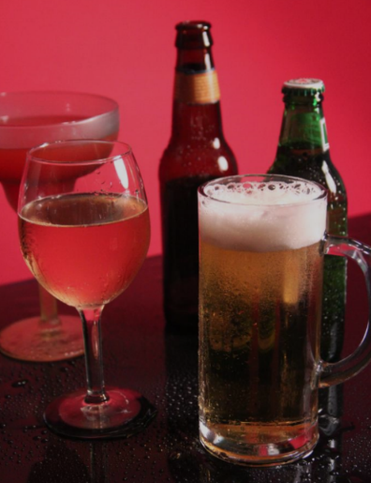
Personal Factors Increasing your Chances for Heat Illnesses
Dehydration
.
Weight, fitness, and diet
- Some medications
- Caffeine, alcohol, nicotine
.
You are responsible to monitor your own personal factors.
Photos from CDC.
Notes:
Some personal factors affect how your body senses and responds to changes in temperature. One is being dehydrated. Poor diet increases the chances of getting ill. Alcohol and drugs affect your body. Working under the influence or with a hangover increase your chances for heat illnesses. Some medications can make you more sensitive to the effects of heat. Consult with your doctor or pharmacists about your specific medication.

Slide 10
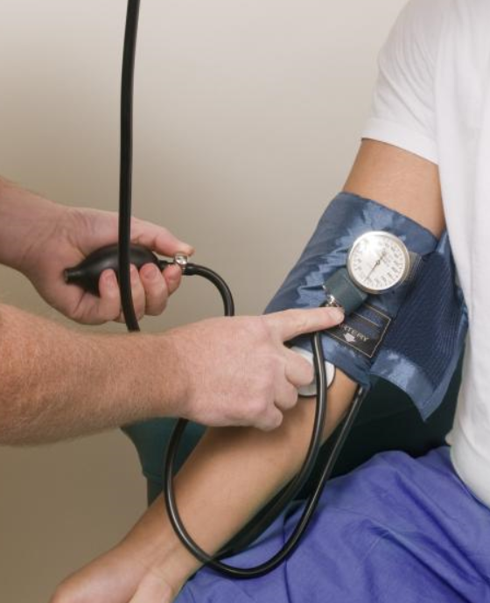
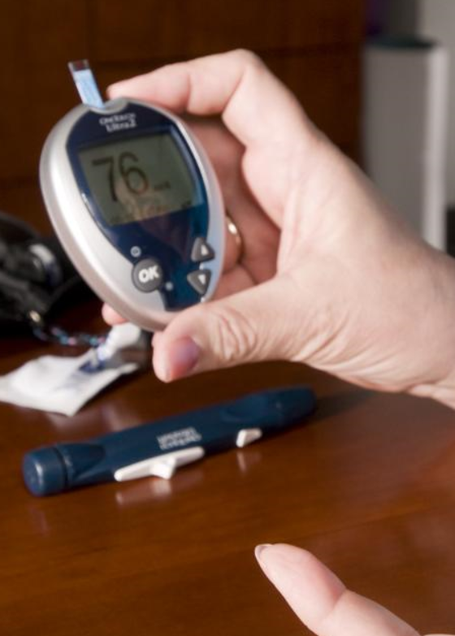
Personal Factors Increasing your Chances for Heat Illnesses (continued)
Age
Medical conditions-
diabetes, heart,
kidney and others.
Lack of sleep.
Pregnancy
Previous heat illness.
Device to measure blood sugar.
photos from CDC/ Amanda Mills
Notes:
As we age our body doesn’t tolerate heat as well as it used to, so we are more susceptible to heat-related illness.
Health problems can also increase the chances for heat related illnesses such as diabetes, kidney and heart conditions, obesity, high blood pressure, flu and others. Your doctor can tell you if any medical conditions you may have make you more sensitive to high temperatures.
Getting about 8 hours of sleep can help you recover from working in hot temperatures. Pregnancy, menopause and other hormonal issues also can affect body temperature. And you are more susceptible if you suffered heat related illnesses in the past.

Slide 11
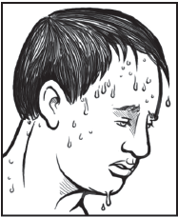
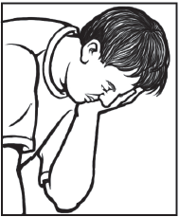
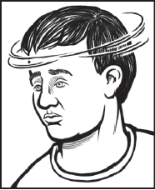
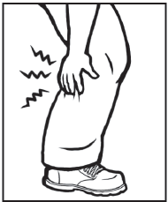
Early Signs and Symptoms of heat illness
Thirst.
Sweat.
Headache.
Dizziness.
Weakness.
Irritability.
Nausea.
Cramps.
Illustrations from OSHA
Notes:
If you don’t feel well, let _______________ know right away. Take action at the earliest signs to prevent getting worse by taking a break, drinking cool water or a beverage and resting in a shaded, cooler area with someone watching over you in case you need medical attention. Sweating is normal and helps the body control its temperature. However, sweating more than normal or not sweating at all can be a sign of a heat illness. If you don’t feel better soon, then you may need medical attention.

Slide 12
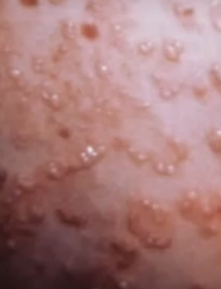
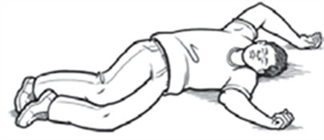
Other symptoms: heat rash and fainting
Heat rash: from sweating usually under clothing.
Photo by PNASH
What you can do: Dry the skin, change into dry clothes.
Fainting: can happen when standing for long periods.
What you can do: Rest and drink water.
OSHA photo
Notes:
These are the less-serious symptoms of heat illness. If your clothes become wet due to sweat it’s a good idea to change into dry clothes to prevent a rash, and let the extra sweat dry. Most people quickly recover from fainting. Reducing long periods of standing is the usual solution. It is also important to prevent sunburns.

Slide 13
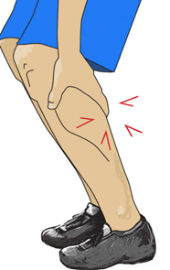
Other symptoms: heat cramps and muscle breakdown
Heat cramps: Muscle spasms, pain,
usually in the arms, legs or abdomen.
What you can do: Drink water and eat a snack. Rest before going back to work.
Muscle breakdown (Rhabdomyolysis): Muscle cramps, pain, abnormally dark urine (tea or cola colored), weakness, exercise intolerance, or no symptoms
What you can do: stop activity, drink water, and seek immediate medical care.
Notes:
Heat cramps can be relieved by drinking water and eating a salty snack.

Slide 14
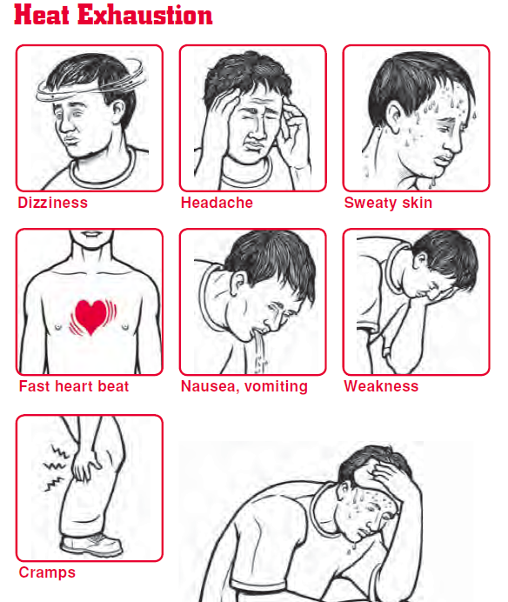
Signs and Symptoms of Heat Exhaustion
Heavy sweating
Headaches
Dizziness
Weakness
Irritability
Nausea or vomiting
Thirst
Fast heart beat
Elevated body temperature
Illustration from Oregon OSHA
Notes:
Heat exhaustion is a serious, but usually not life-threatening condition, but if left untreated it may lead to heat stroke. If you experience these symptoms, we want you to do the following: [say what your company’s practices are here.]
Never ignore anyone’s signs or symptoms. You can prevent a medical emergency if you act early.
Heat exhaustion or heat stroke may develop over a few days. If you had some symptoms yesterday, you are more susceptible today.
Note: pesticide poisoning and heat exhaustion have similar symptoms, and the differences will depend on the pesticide family. Two differences are the dilated (opened/large) pupils and dry mouth from heat versus small pupils and salivation from poisoning with organophosphates/carbamates pesticides. Pesticide poisoning and heat stroke can be life-threatening, and both require immediate treatment.

Slide 15
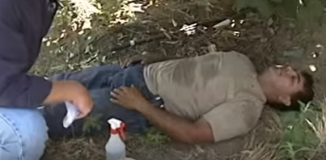
Heat Stroke: A Medical Emergency
Signs include:
Hot, dry skin or excess sweating
Confusion
Slurred speech
Collapse (coma)
Seizures or convulsions
Very high body temperature
L&I photo
Heat stroke requires immediate medical attention. It can be fatal.
Notes:
If a worker loses consciousness or appears confused, it may be heat stroke. Heat stroke can be fatal or cause permanent disability. Heat stroke can occur without any warning signs. Do not delay medical attention.

Slide 16

Progression of heat illness
Heat Exhaustion
Heat Stroke
Dehydration
Heat exhaustion may progress to heat stroke if not treated.
Notes:
Never ignore anyone’s signs or symptoms. You can prevent a medical emergency if you act early. If you had some symptoms yesterday, you are more susceptible today. Heat exhaustion or heat stroke may also develop over a few days.

Slide 17
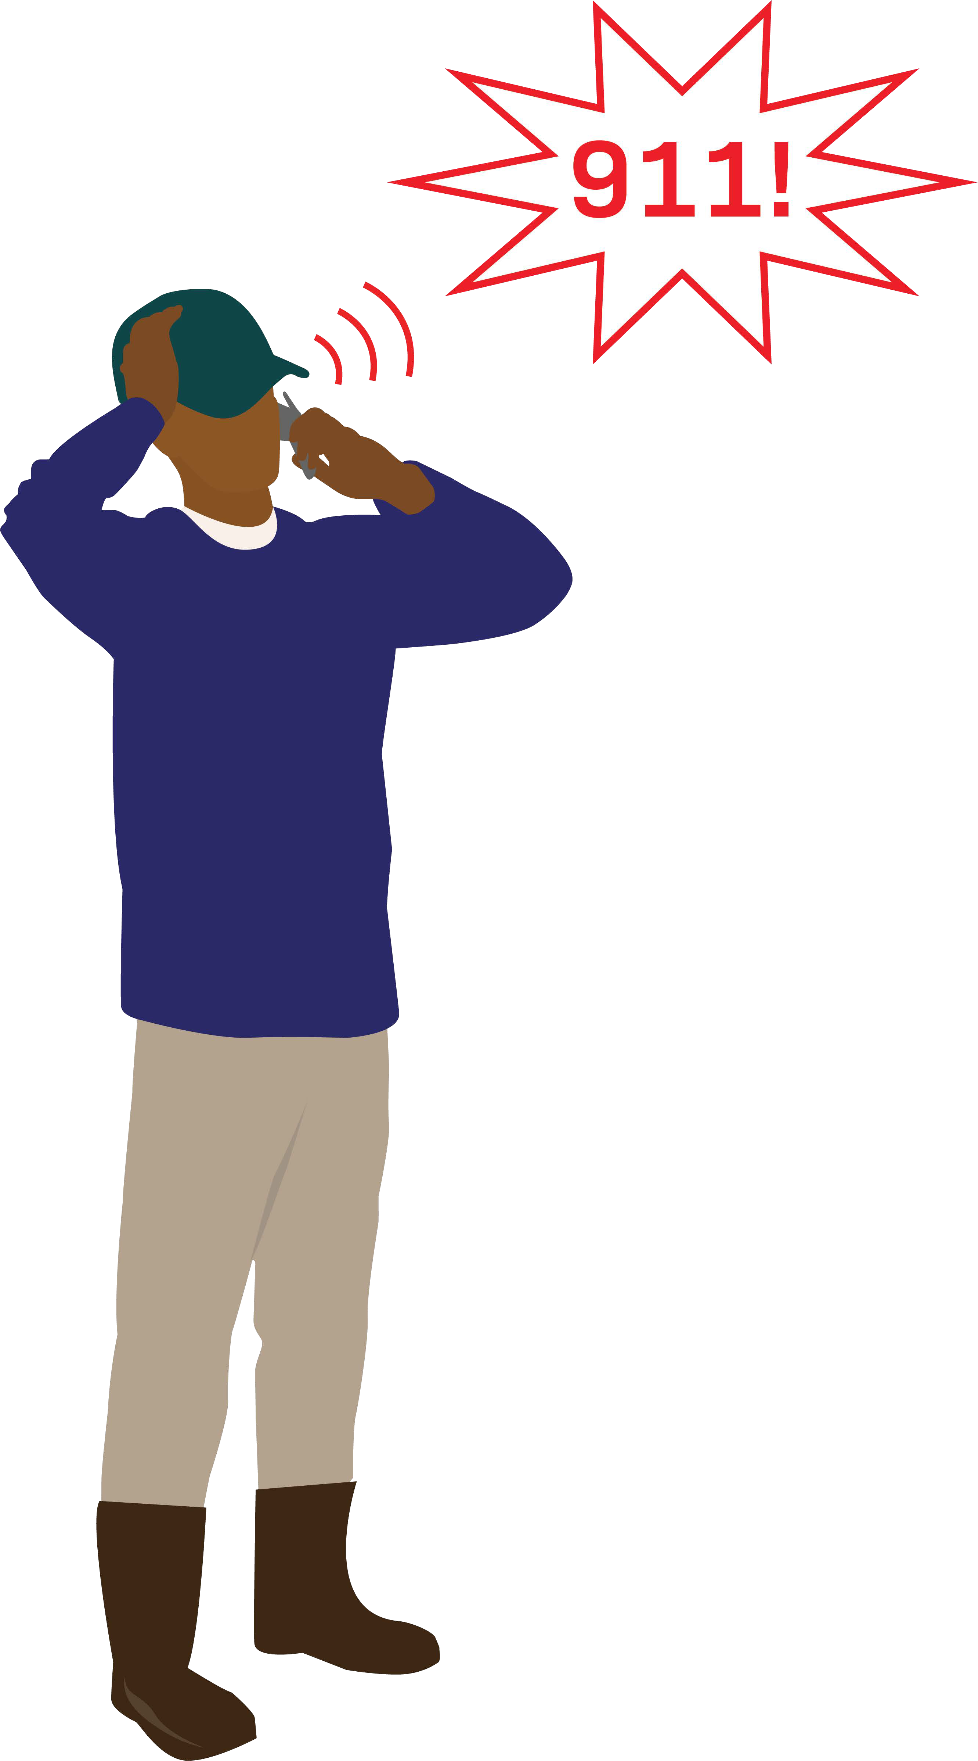
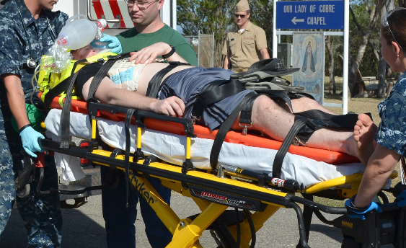
Is it Heat Stroke or Heat Exhaustion?
Image from Cal OSHA
Photo by US Navy in Wikipedia Commons
Notes:
Sometimes it is difficult to know if a person is experiencing heat exhaustion or the more serious heat stroke. If someone seems confused, disoriented or is acting strangely on a hot day, ask if they are okay because they may be experiencing heat stroke and need to be treated immediately. Call 911 and seek immediate medical care if you are not sure.

Slide 18
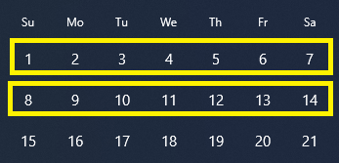
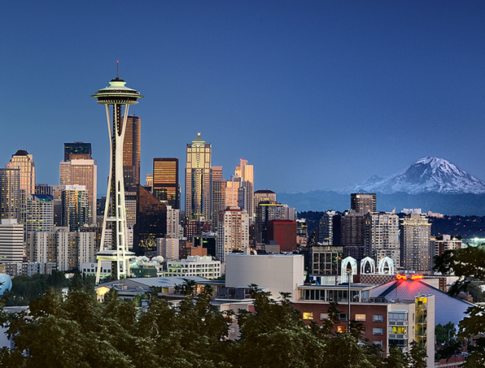
Getting Used To The Heat
It takes about two weeks to fully get used to working in hot temperatures.
You lose that adjustment if you have been away from the heat for a week or more.
Western Washington has irregular heat waves and workers have less opportunity to get used to hot conditions.
Photo by Bula Sivakumar in Creative Commons
Notes:
According to Federal OSHA, about Seventy percent of outdoor heat related deaths happen during the first week. If you haven’t worked in hot conditions for a week or more, for example you are new to the job, new to the hot environment, or have been away for a while, you need time to adjust and get used to the conditions. It is important to recognize that we are all different so each person’s tolerance to heat is unique. A sudden heat wave is something most will not be adjusted to. You may need to take more preventative cool-down rest periods and pace your work during the first 2 weeks of working in hot temperatures so you don’t overheat.

Slide 19
When it’s 89°F or hotter
Everyone must take a cool-down rest period of at least 10 minutes every 2 hours.
Workers must be closely observed for signs and symptoms of heat illness.
Supervisors and workers must have a reliable way to communicate at any time.
Rest periods are paid unless taken during a meal period.
Notes:
[Share any specific practices and procedures for how you will ensure all three requirements are met. For example, describe how workers will be observed; will you use a buddy system or some other method?]

Slide 20
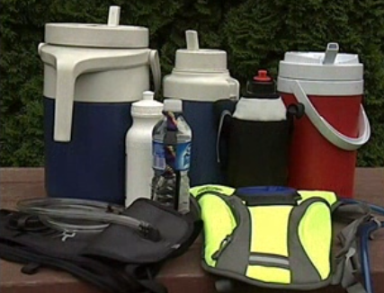
Prevention: Drink plenty of water
Start work well hydrated.
Drink small amounts of water often:
  1 cup every 15 minutes.
Don’t wait to be thirsty.
Keep hydrated after work; and get enough rest.
Photo from L&I
Notes:
Water is the best way to replace fluids. It is better to drink small amounts often.
A cup or ¼ of a liter every 15 minutes is better than drinking a quart or liter all at once.
Drinking too much water all at once can also be harmful, no more than 12 quarts a day is recommended.

Slide 21
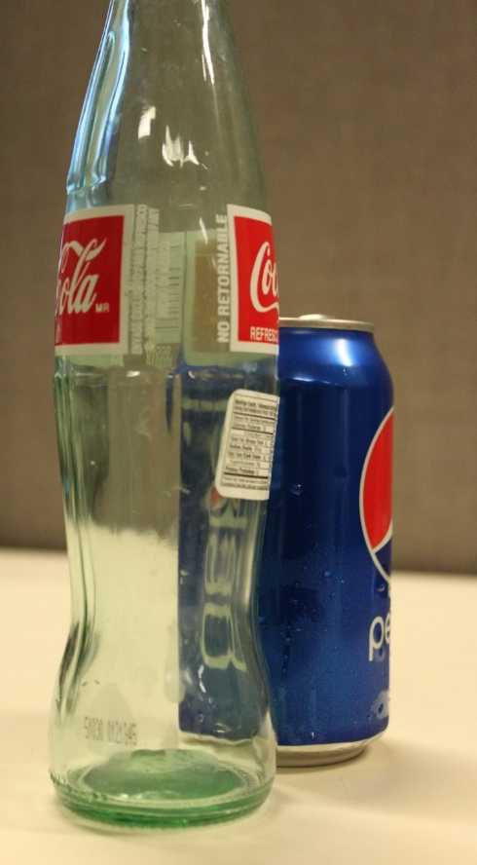
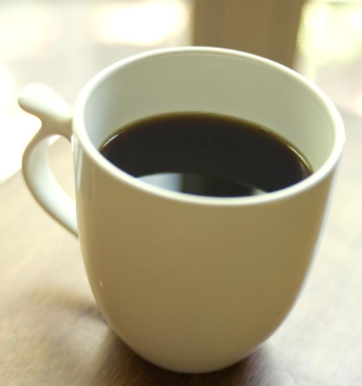
Prevention
Avoid:
Waiting to be thirsty to drink water.
Sodas and sugary drinks.
Lots of caffeine such as energy drinks.
Working with a hangover.
Avoid sodas and
sugary drinks.
photos from CDC
Limit
caffeine
Notes:
Sodas and other drinks containing caffeine and sugar will not prevent dehydration.
Generally, snacks and meals replace the salt and minerals lost in sweat. There is no need to take salt tablets, and these can irritate the stomach, cause nausea and other discomforts.

Slide 22
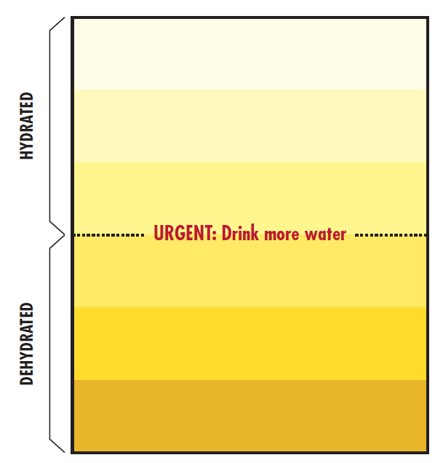
You can monitor yourself by urine color
You want it above this line
Diet, some medication and health
conditions can change the urine color.
From NIOSH Criteria for a Recommended Standard,
Occupational Exposure to Heat and Hot Environments, 2016.
Notes:
In general, when you are hydrated the urine should be clear or pale yellow. A darker color can be a sign of dehydration or heat illness. Diet (like eating beets), vitamin pills, medications, and certain health problems can also change the color of urine.

Slide 23
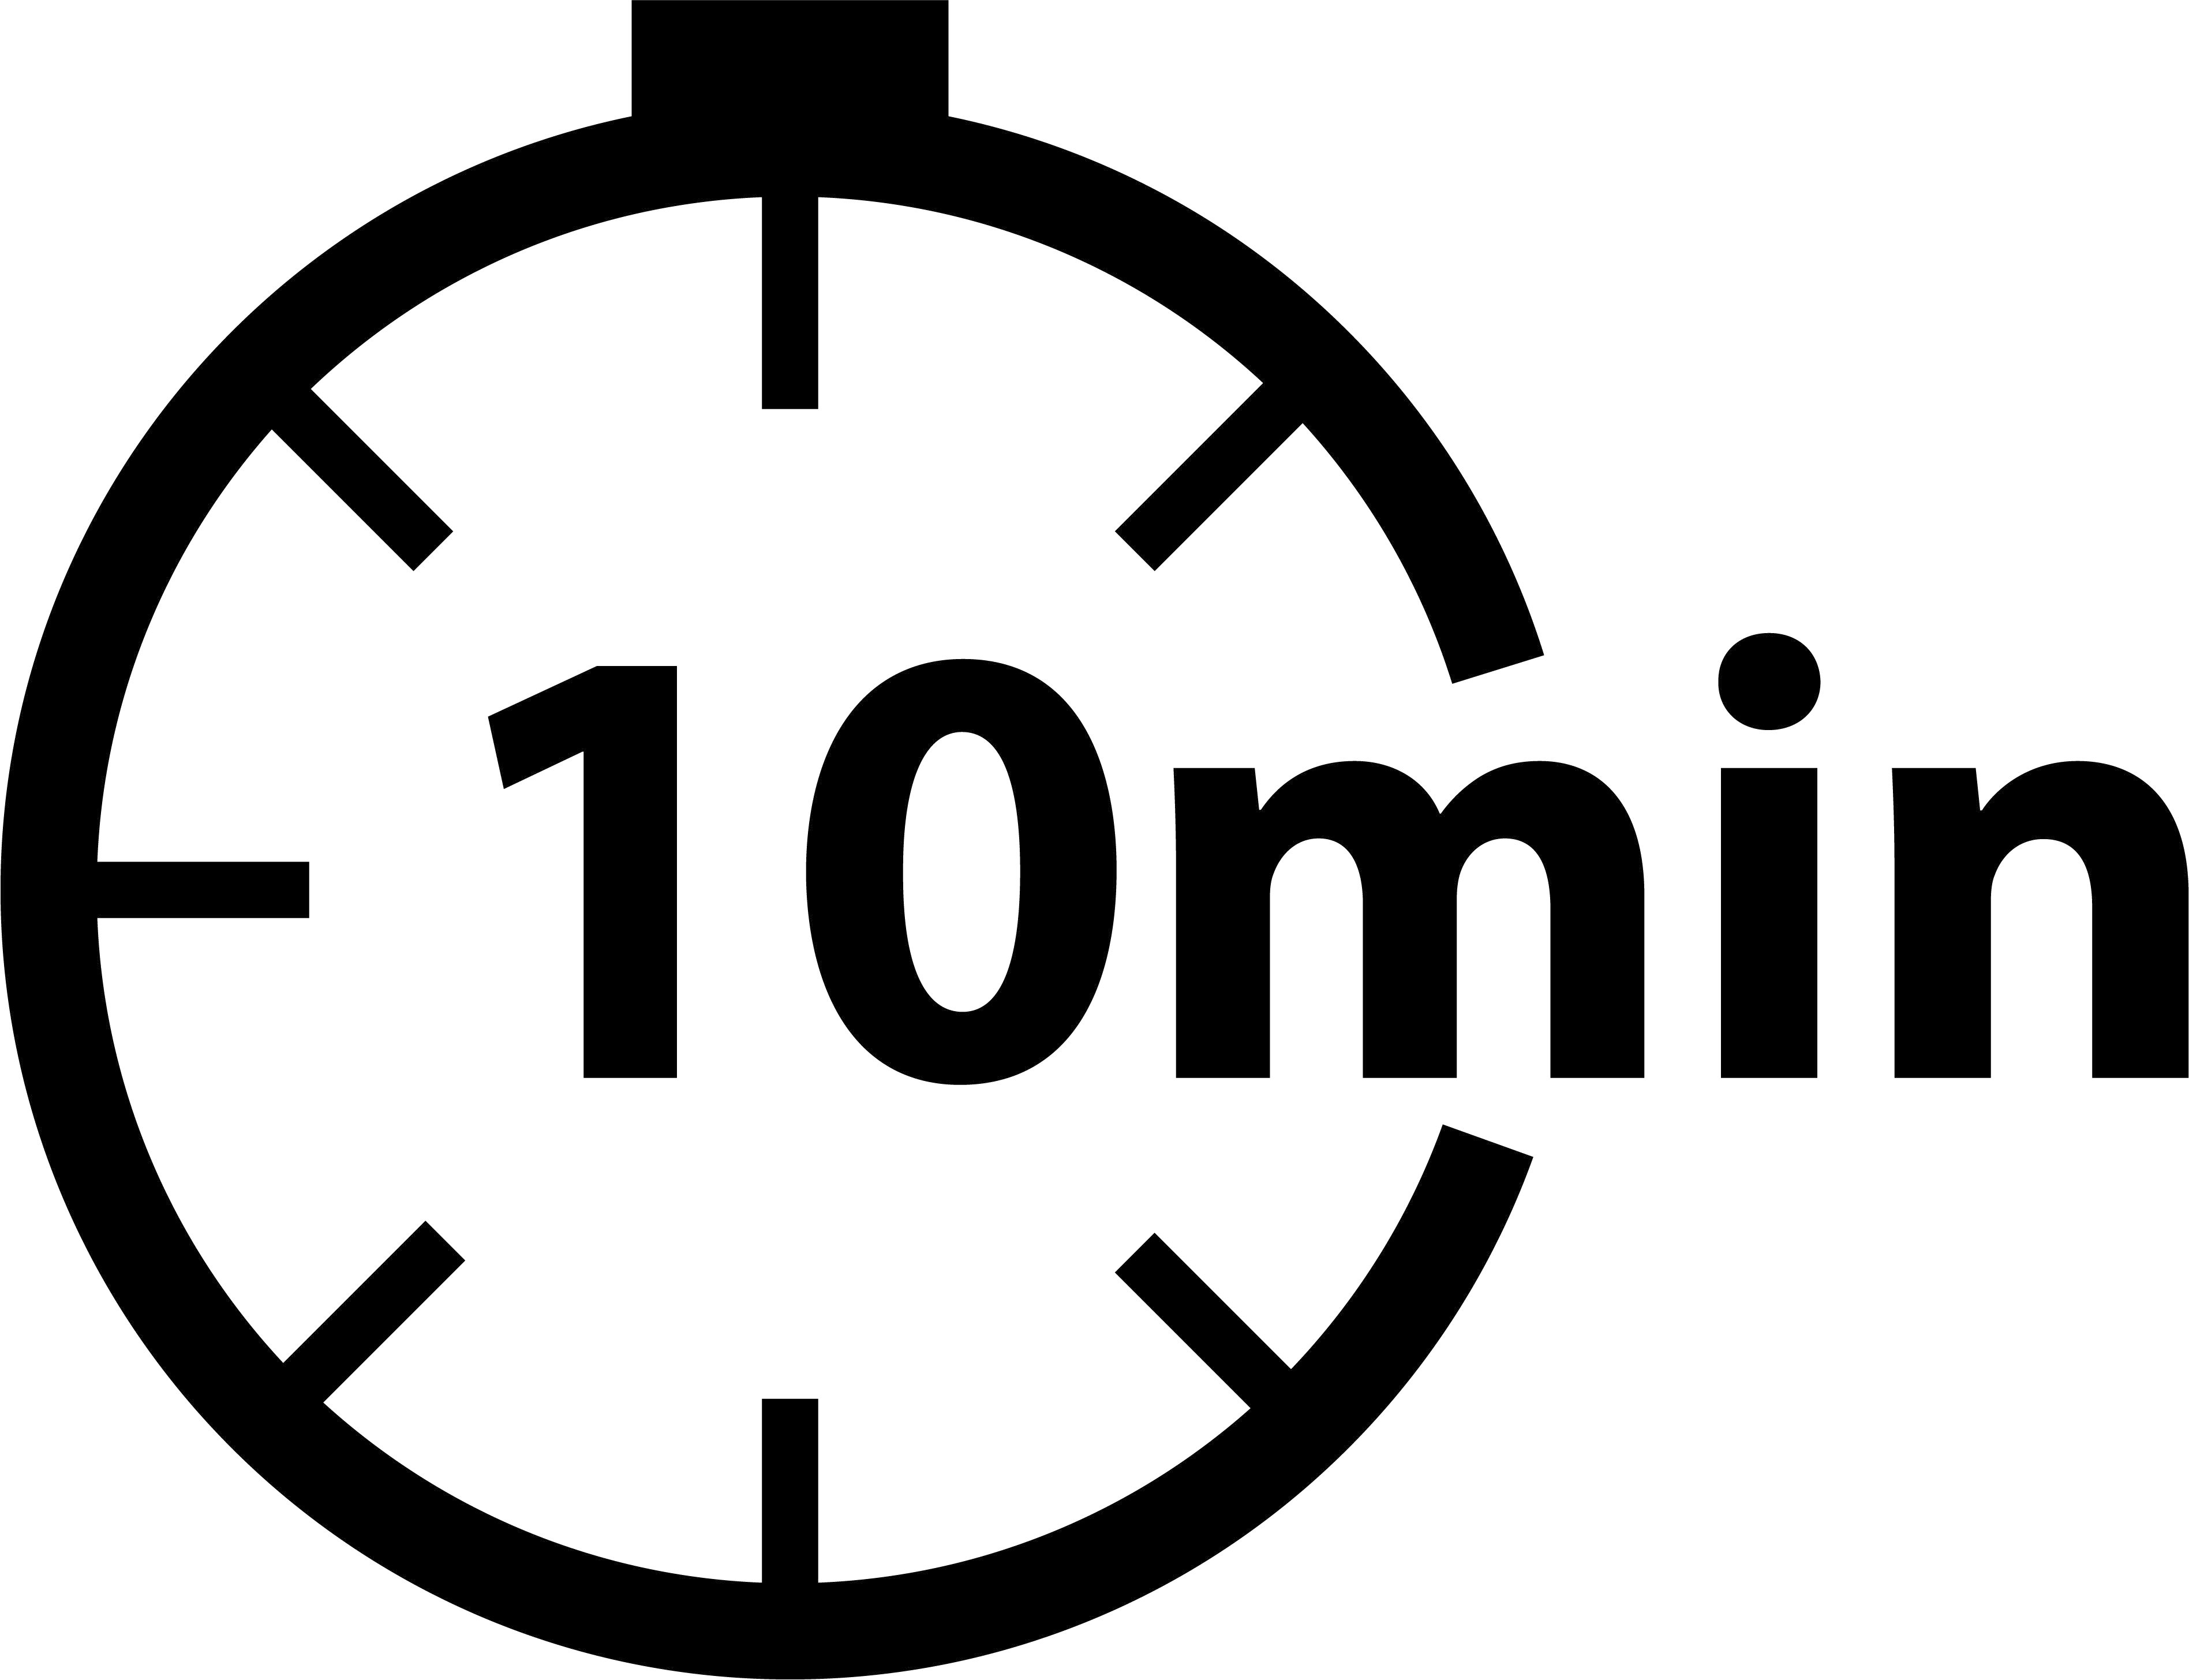
Taking Breaks
Remove any unnecessary clothing or PPE. It allows sweat to evaporate and your body to cool off
Rest in the shade or a cool area
Drink cool water
At 89⁰ F, mandatory cool-down rest period of at least 10 minutes every 2 hours
You are encouraged and allowed to take preventative cool-down rest periods at other times when L&I’s heat rule applies
Cool-down rest periods are paid work time unless taken during a meal
Image from CalOSHA
Notes:
Cool-down rest periods of at least 10 minutes every two hours are required when temperatures reach 89 degrees. Cool-down rest periods are paid breaks except when taken during a meal period.
Whether conditions are at the 89, 77 or 52 degree Action Level, depending on what you are wearing, you are encouraged and allowed to take a preventative cool-down rest period whenever you feel the need to protect yourself from overheating. You will be paid for cool-down rest periods except when taken during a meal period.
[Mention how and where employees can take their cool-down rest periods such as the location of shade or other acceptable alternative.]

Slide 24
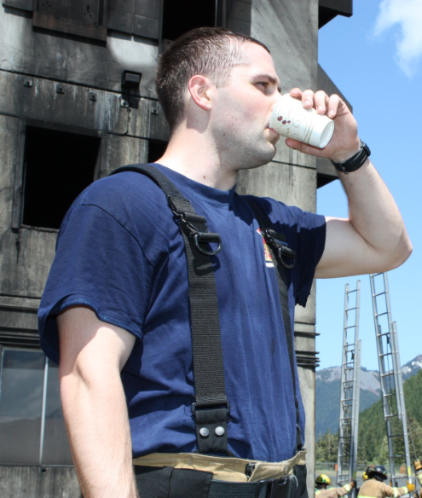
What to do if you experience heat illness symptoms
Tell the person in charge or co-workers that you need a break from the heat.
Remove unnecessary clothing and any PPE being worn.
Move to a cool, shady area.
Drink cool water or an acceptable beverage.
Photo from L&I
Notes:
[Describe the site specific measures they need to follow.]

Slide 25
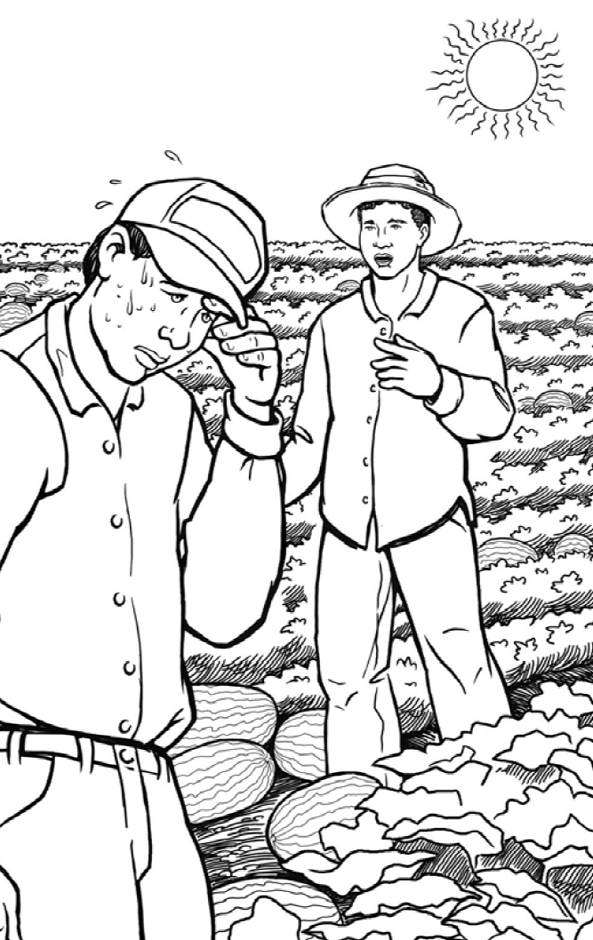
What would you do if a co-worker shows signs of heat illness?
1. Keep working.
2. Tell the foreman or crew leader.
3. Have the person sit or lie down in a cooler area. Give cool water or other cool beverage to drink.
Illustration from Cal/OSHA
Notes:
We don’t want you to ignore any symptoms of heat illness you may notice in a co-worker. We want you to tell your boss if they are available, and have the person do #3

Slide 26
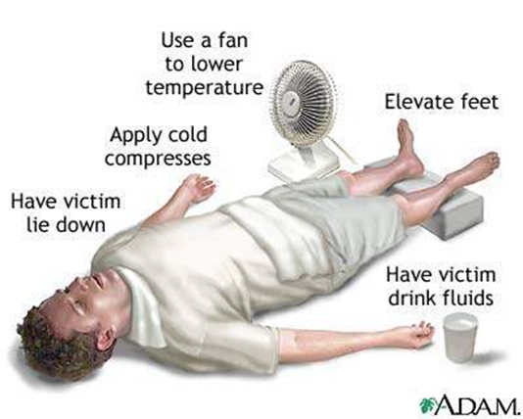
What to do if a co-worker is showing heat stroke symptoms
The person needs to be immediately and rapidly cooled down.
Call foreman or crew leader immediately if a worker loses consciousness or appears confused.
Remove extra clothing and PPE if worn.
Place ice packs or wet towels over the body if available. The goal is to reduce the body temperature.
Don’t leave the person alone.
Photo my Medline Plus and A.D. A. M
Notes:
A person suffering heat stroke is often too ill or confused to take care of themselves, and may need your help.
If someone experiences any of these symptoms, we want you to:
[Describe your site specific measures workers need to follow including when 911 should be called.]

Slide 27
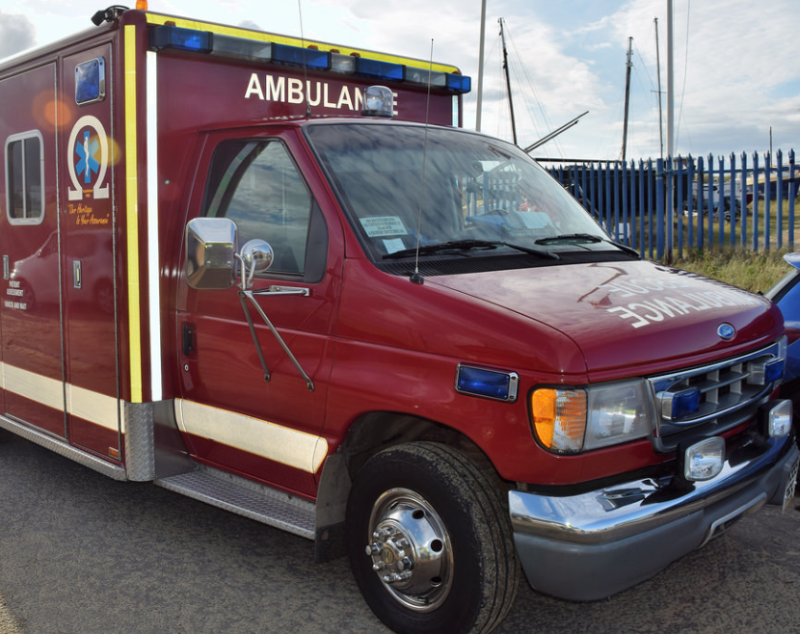
Emergency Medical Services
  Notify security (253) 879-3311 and call 911 if there is an emergency.
  Know how to give directions to your location if emergency services ask.
  Provide first aid to person as needed, while waiting.
Notes:
[Include the specific actions you want your supervisors and employees to take in a heat illness emergency. You could refer to a bulletin board or location where the information is posted, and location of first aid supplies. For example, provide a map of the site with clear directions including road names, distances and markers to avoid delay of emergency services. In remote locations or undeveloped areas you may have a worker go to the nearest point where the emergency responders can see them.]

Slide 28
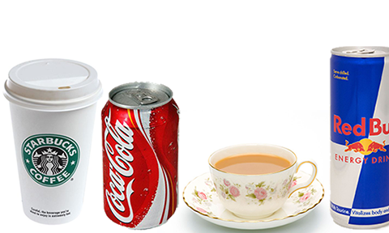
Soda and coffee are the best way to hydrate.
a. True
b. False

Slide 29
That’s Right!
False, water is. Avoid sugar and caffeine.
Continue quiz →

Slide 30

Oops, that’s incorrect….
Try again → Continue quiz →

Slide 31
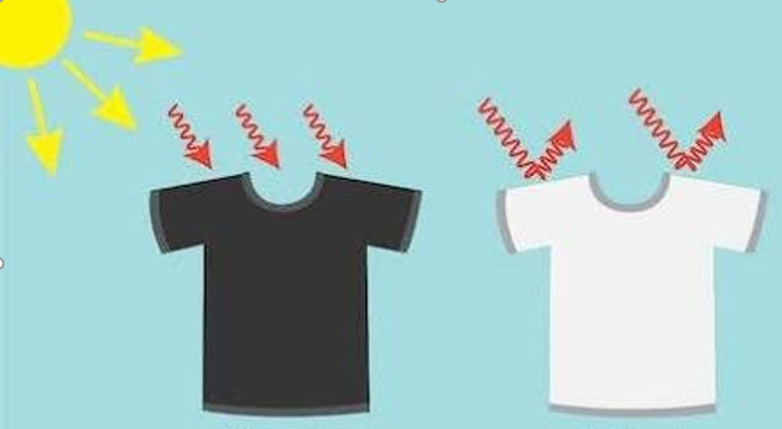
2. Light colored clothing is better than dark clothing when working in hot conditions.
a. True
b. False

Slide 32
That’s Right!
True, light colored reflects most of the visible wavelengths which in turn, absorbs less heat
Continue quiz →

Slide 33
Oops, that’s incorrect….
Try again → Continue quiz →

Slide 34
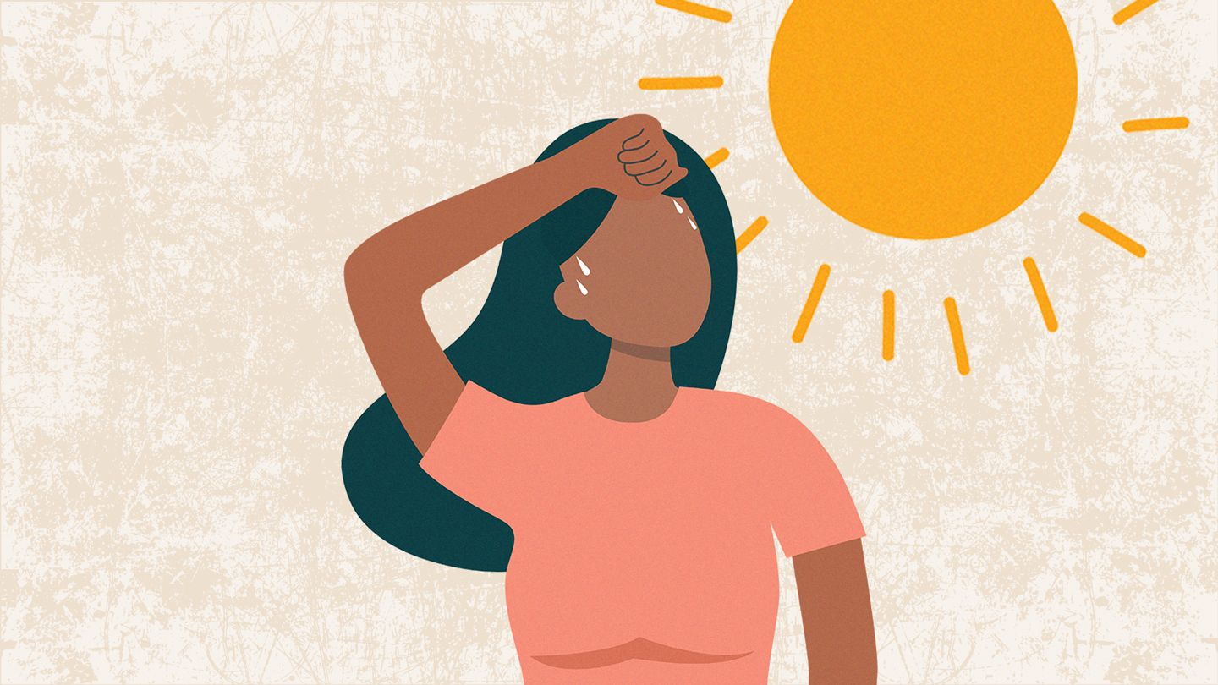
3. It’s recommended to wait to be thirsty and drink a lot of water.
a. False
b. True

Slide 35
That’s Right!
False, a cup at least every 15 minutes is recommended. If you are thirsty, you are dehydrated.
Continue quiz →

Slide 36
Oops, that’s incorrect….
Try again → Continue quiz →

Slide 37
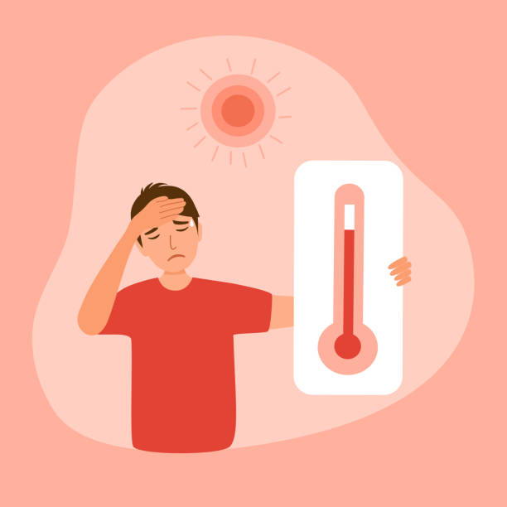
4. Your medicine may make you more vulnerable to heat-related illness
a. True
b. False

Slide 38
That’s Right!
True, consult with your doctor.
Continue →

Slide 39
Oops, that’s incorrect….
Try again → Continue →

Slide 40
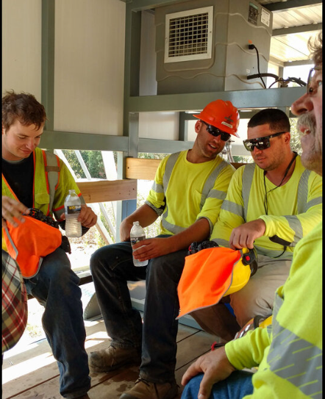
Summary: Take Action to Prevent Heat Illnesses
Gradually get used to hot working conditions
Alternate between heavy, moderate, and light work when possible
Wear light colored and breathable clothing
Wear sunscreen and a hat
Shade
Water
Rest

Slide 41
Summary - Take Action to Prevent Heat Illnesses (continued)
Drink water often throughout the day. Don’t wait to feel thirsty.
Take breaks in a cool area and rest.
Remove PPE during breaks.
Monitor your personal factors that could increase your chances for heat illnesses.
Watch each other for the signs and symptoms of heat illnesses.

Slide 42
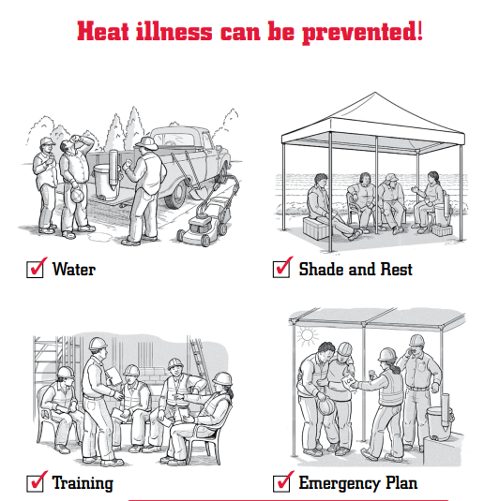
Resources
Preventing Heat-Related Illness Card (L&I)
Heat Safety Illustrated (OSHA)
Lni.wa.gov/HeatSmart resource page
Notes:
[These links are optional. L&I’s Be Heat Smart webpage has additional information for workers]

Slide 43
Thanks for participating!
Please send an email confirming you’ve completed this training to: znavarrete@pugetsound.edu or mattjohnson@pugetsound.edu

