Slide 1
An Introduction to
Computer-assisted Text Analysis: Comparing Characters’ Language Styles
[Presenter]
[Date]

Slide 2

Computer-assisted Text Analysis
Computer-assisted text analysis supports a different kind of reading than we usually do in a literature course. Whereas in the latter we usually engage in “close reading,” when we do computer-assisted text analysis we are doing what some practitioners have come to call “distant reading” or “macroanalysis.” It involves thinking about literary texts as collections of linguistic data, and, with the help of software, looking for patterns that we might have missed before.
Why would we want to do that? Because it encourages us to…
revisit questions we thought we knew the answers to, and
ask new questions that would never have occurred to us previously.
What kinds of questions?

Slide 3
Computer-assisted Text Analysis
To get at an answer that question, I’m going to pose another one: How do characters “come to life” in a novel? In other words, by what process do we come to believe that these imaginary creatures are real?
They do things.
They say things.
They “think” things.
Other characters say and think things about them.
In a skillfully written novel, all of this happens with the consistency--or inconsistency but distinctiveness--that we expect of individual human beings.
The medium through which these phenomena are represented is, of course, language. A text. Words on a page. And as we’ve said, a text is, among other things, a collection of data that lends itself to analysis.

Slide 4
Computer-assisted Text Analysis
Our starting point for this analysis, then, is, “What is going on in the language of character A that would convince us that s/he is a different being than character B?” Our assumption is that this belief in the integrity of imaginary characters is fundamental to our experience of fiction. This is precisely the sort of question that computer-assisted text analysis is best suited to help investigate.
For this demonstration, we’ll look at the language of the two main characters in The Coquette, a novel published in 1797 by Hannah Webster Foster. The Coquette is an epistolary novel, which is convenient: it provides pre-defined data sets of our characters’ language.
Note: Your data sets need to reflect the level of discourse you’ve chosen to analyze. For example, if you wanted to analyze differences from chapter to chapter of one work, or differences in the dialogue of two characters, you’d need to import the texts as discrete collections (chapters or separate collections of dialogue) so the software would be able to tell them apart.

Slide 5
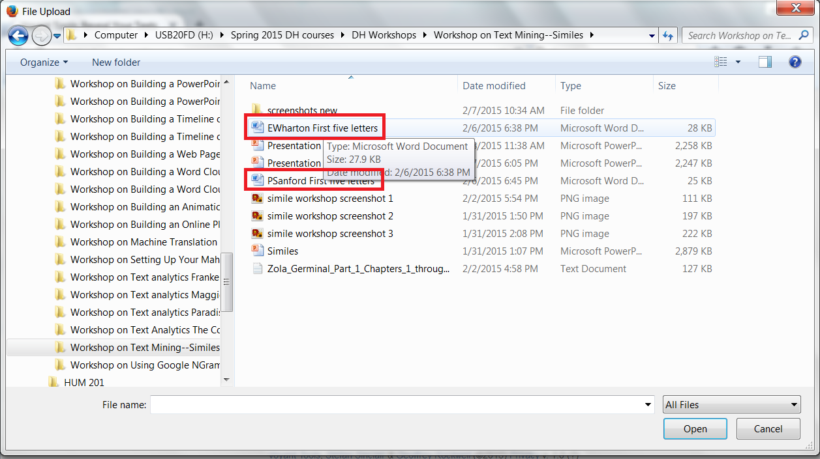
Analyzing Characters’ Language
I’ve created two separate files containing the first five letters, respectively, “written by” Eliza Wharton and Peter Sanford, the two main characters in The Coquette. (I downloaded the plain-text version of the novel from www.Projectgutenberg.org then saved the excerpts as separate files.)

Slide 6
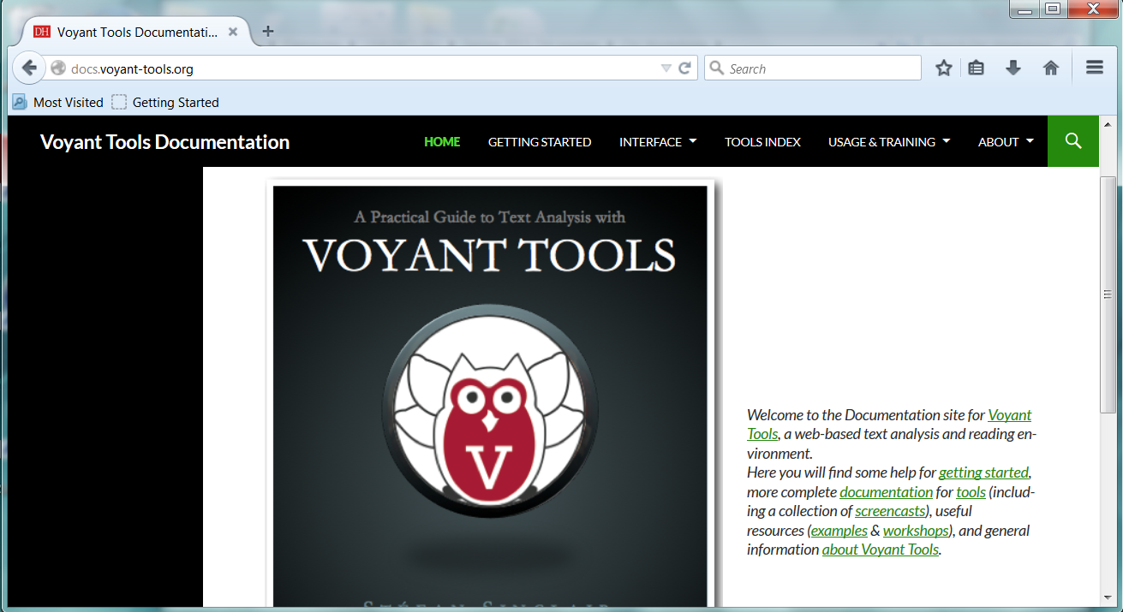
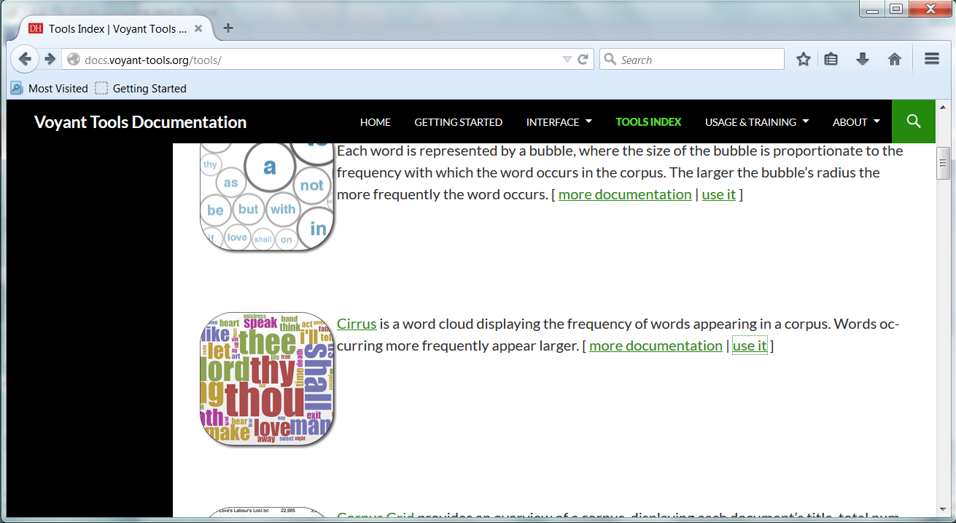
Analyzing Characters’ Language
You’ll start by going to http://docs.voyant-tools.org/ . This will bring you to the Voyant documentation page, which contains a list of all the Voyant text analysis tools.
Now click on Tools Index, then find the Cirrus word cloud tool and click Use It.

Slide 7
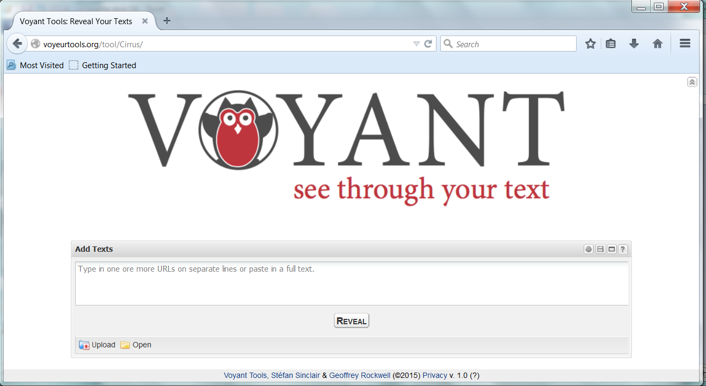
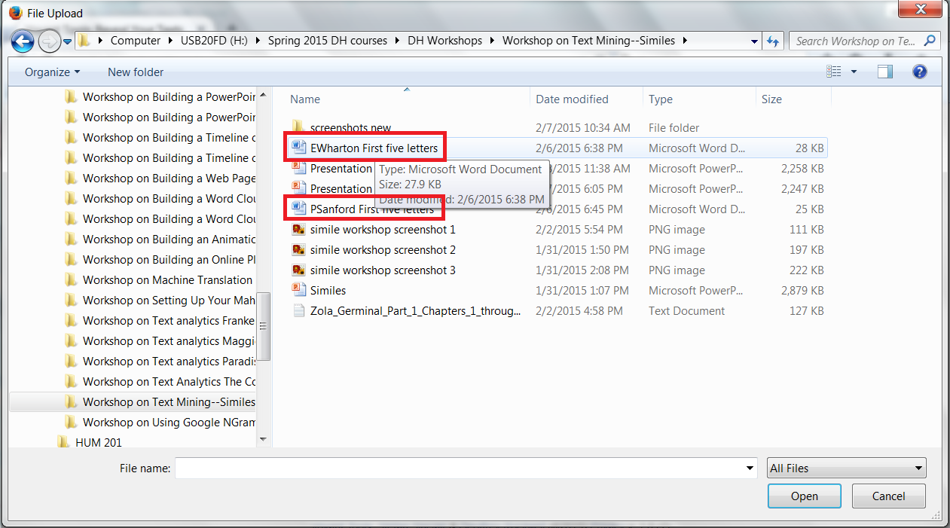
Analyzing Characters’ Language
This takes you to the text input window. In the lower right is the Upload button. Click on that button, then browse to the location of the first file you want to load into the tool. Repeat this process for the other file.

Slide 8
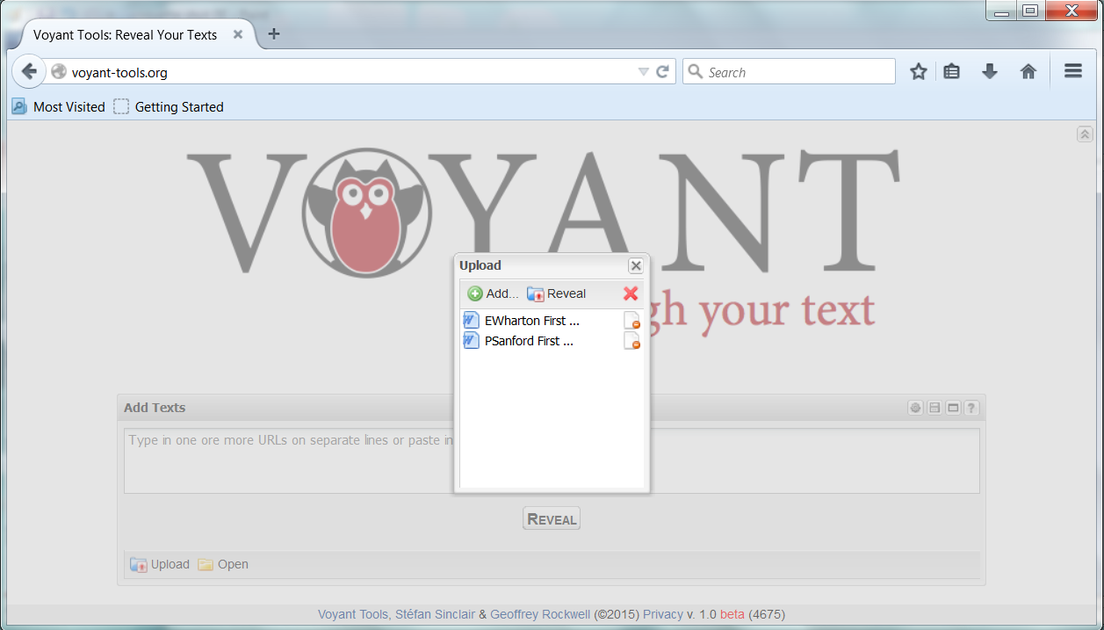
Analyzing Characters’ Language
4. Once you have both files uploaded, click Reveal.

Slide 9
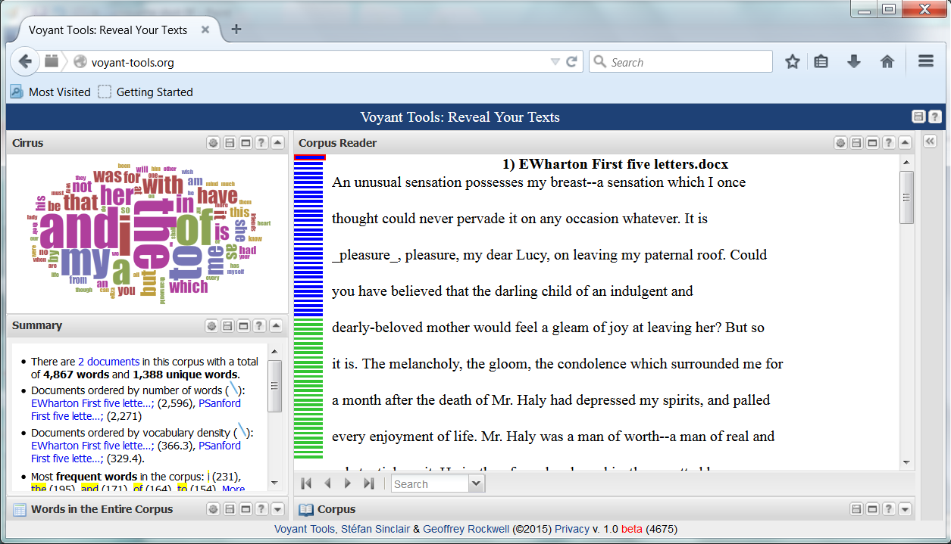
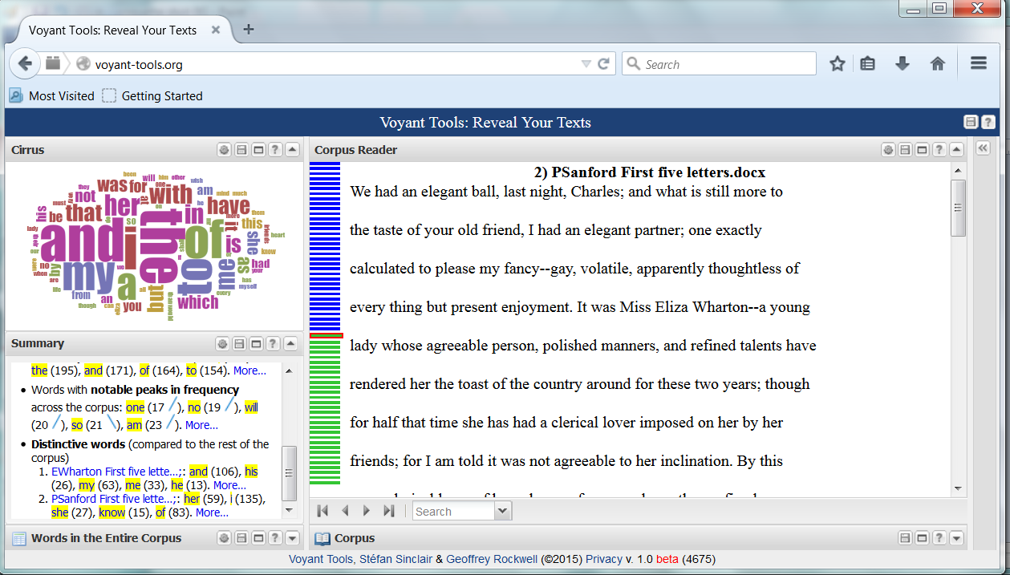
Analyzing Characters’ Language
On the far left you should see a composite word cloud and, below that, a short summary of statistics about these two texts. The reading pane shows Eliza’s first letter. To see Peter Sanford’s letters, click the top of the green column, which represents the beginning of that file. Click the blue column to go back.

Slide 10
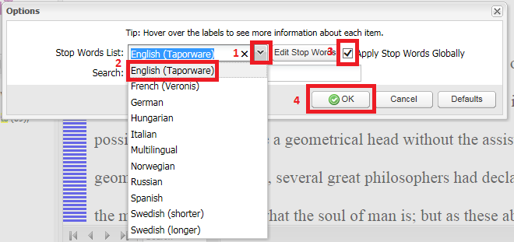
Analyzing Characters’ Language
Then, on the dialog box, make the selections in the order shown below.
Now we’ll look at the words that Peter and Eliza use most often. Note that the word cloud isn’t very interesting. It’s full of the “function” words that appear most frequently in English. To get rid of them so the word cloud contains only “content” words, click the Tool icon above the word cloud.

Slide 11
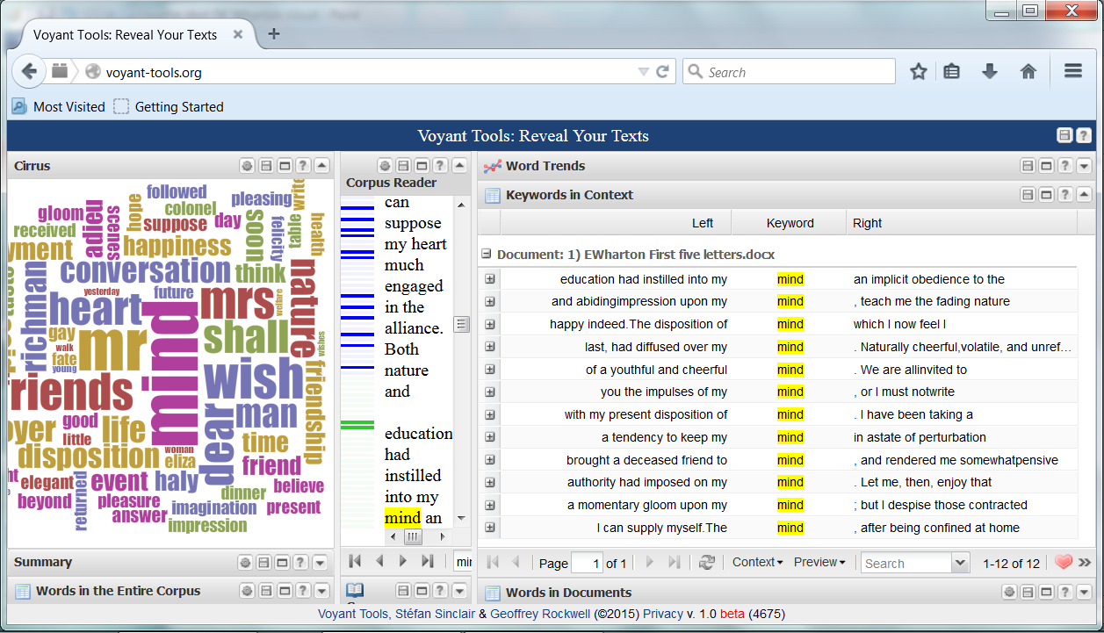
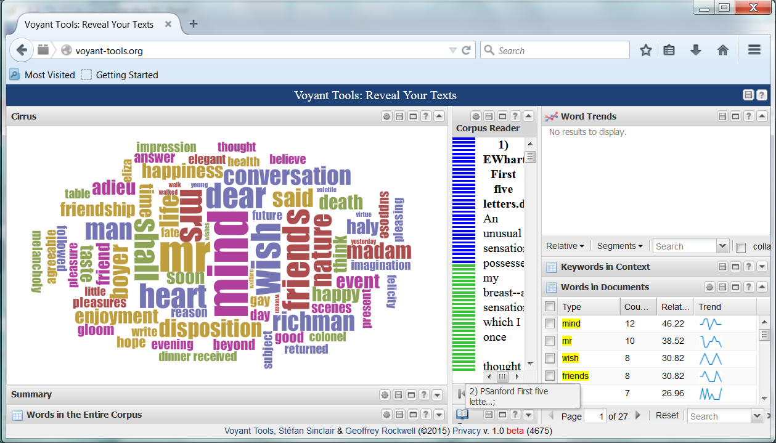
Analyzing Characters’ Language
You should now see a word picture with a different set of words from before. These are the “content” words Eliza uses most often. In the lower right corner, you’ll see a list of those words ranked by frequency of use. When we click the box next to a specific word, we see that word in context.

Slide 12
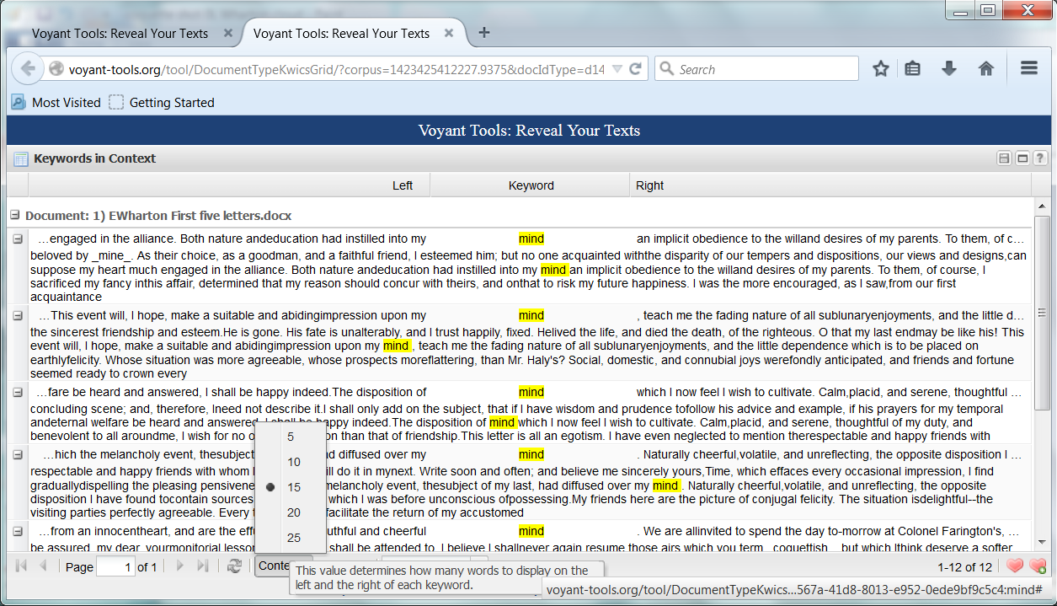
Analyzing Characters’ Language
We can open the Keywords in Context tool in a separate window to see how Eliza uses the word “mind” in context. And we can change the number of words we want displayed on either side of the keyword.

Slide 13
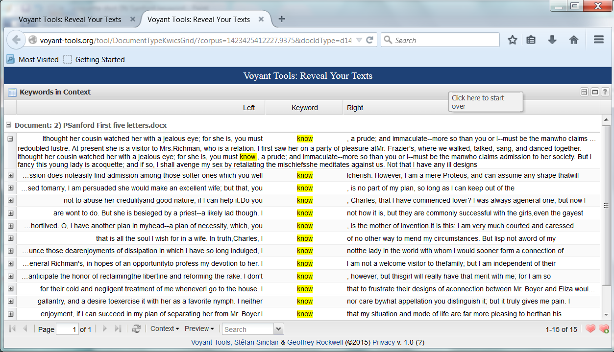
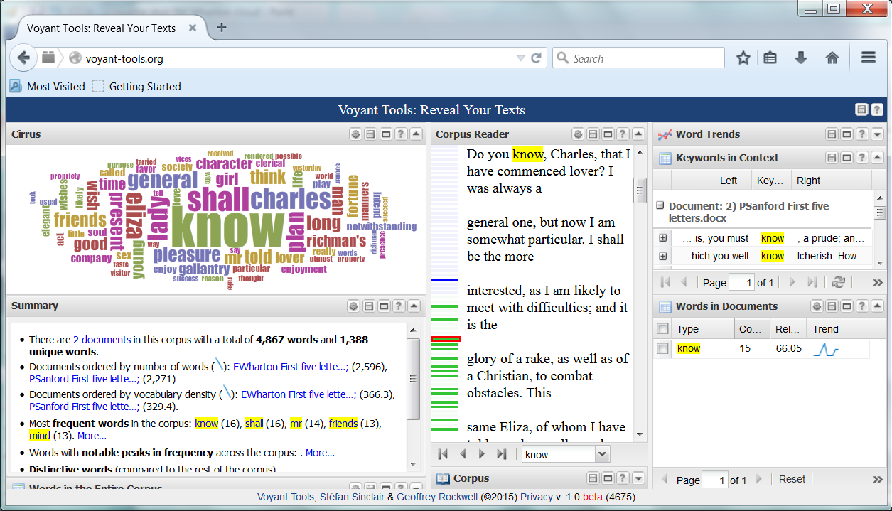
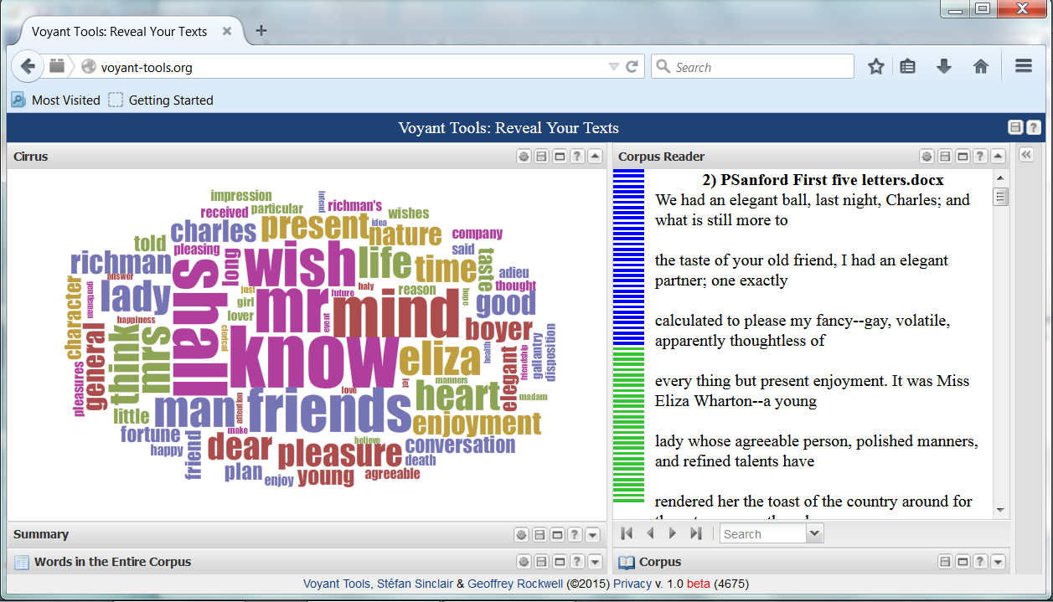
Analyzing Characters’ Language
We can do the same with the list of Peter Sanford’s most used words, beginning with know.

Slide 14
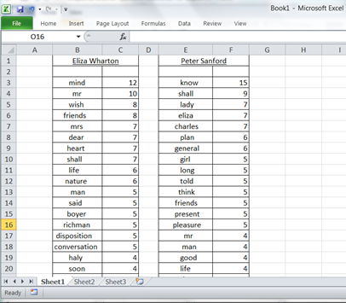
Analyzing Characters’ Language
Sometimes a word list is worth a thousand pictures. Here’s a spreadsheet showing the top twenty content words that Eliza and Peter use most often in their first five letters. What if anything strikes you about these two lists?

Slide 15
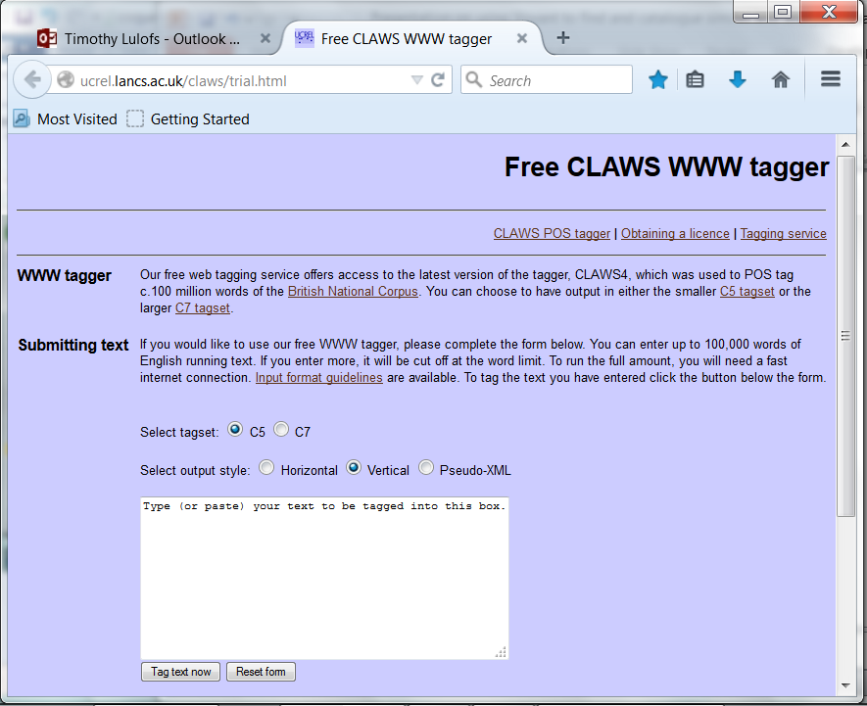
Analyzing Characters’ Language
Now we’re going to apply another tool to Eliza’s and Peter’s prose styles. This tool is called a Part-of-speech (POS) Tagger. You feed a text into it and it will read and identify the part of speech of every word.
There are a lot of POS taggers out on the web. This one, from the University of Lancaster, is really easy to use and quite robust. (Thank-you to Billy Rathje for pointing me to this one.)
http://ucrel.lancs.ac.uk/claws/trial.html

Slide 16
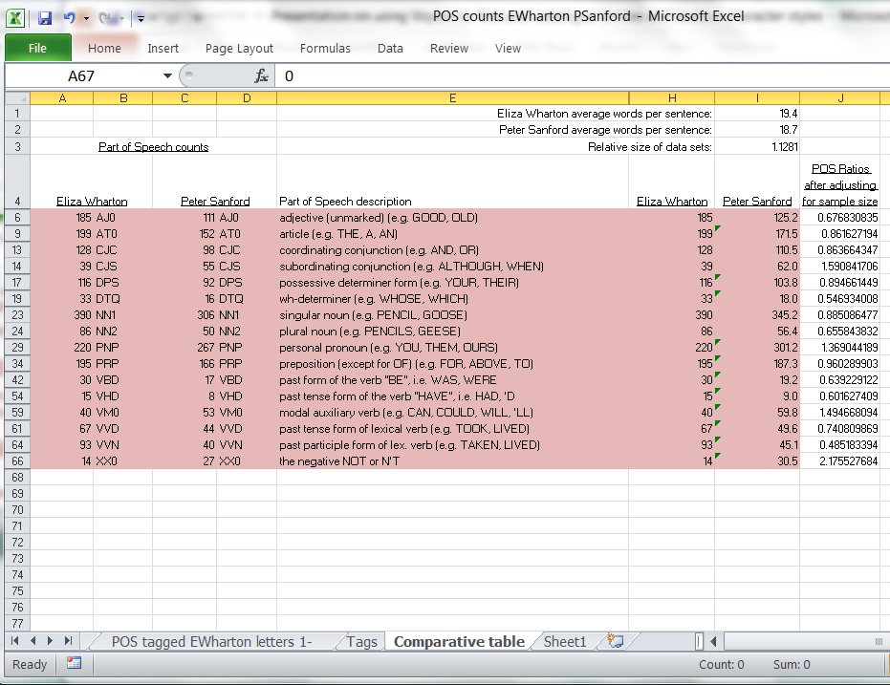
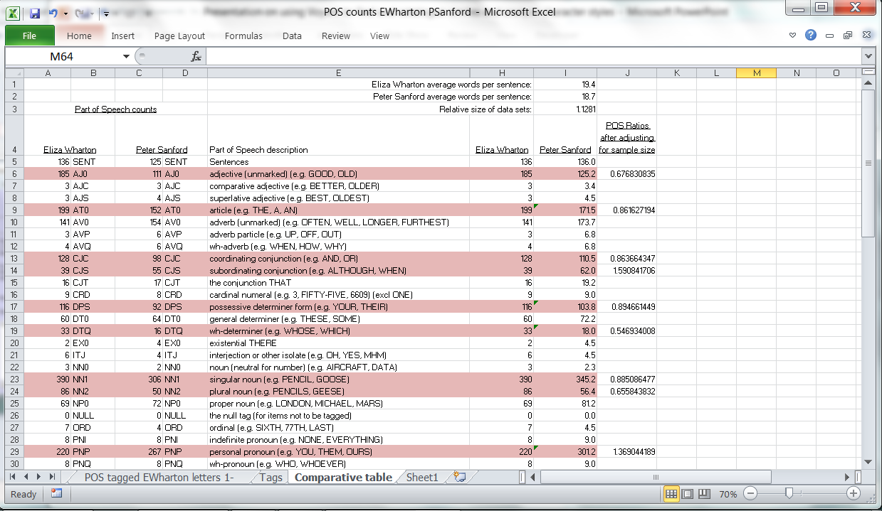
Analyzing Characters’ Language
I ran the two sets of five letters each through the POS tagger. Then I copied the outputs from both runs to an Excel spreadsheet and created a comparative table. The variances shaded in pink here struck me as interesting, so…
…I collapsed them down to a manageable size.
Then I inserted a bar chart in Excel to see the differences more clearly.

Slide 17
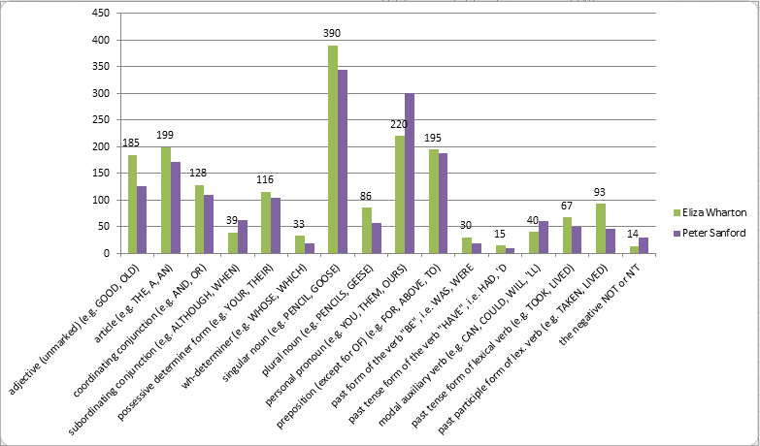
Analyzing Characters’ Language
Here’s the chart highlighting some of the differences in the two characters’ use of language based on what the POS tagger found. (Sample sizes have been normalized.)
Eliza uses more adjectives than Peter.
Eliza‘s sentences are less syntactically complex than Peter’s.
Eliza’s sentences have many more nouns than Peter’s. His sentences have many more pronouns than hers.
Eliza uses the past tense much more than Peter.
Peter uses modal verbs (conditional and future tense) much more than Eliza.

Slide 18
Things to think about
A couple of parting questions—and tentative answers…
Q: Are the data we’re working with here a statistically valid sample from which to draw conclusions?
A: Well, first of all, let’s clarify what we are trying to draw conclusions about. We’re making claims about the way language appears to be working in a particular novel. We aren’t proposing that literary language always works in precisely the way we’re investigating here. Even having said that, I think we’d do well to apply the same methodology to the entire text of The Coquette to see if the trends we’ve uncovered here are consistent for these two characters throughout the novel.
Q: Is a pattern that no one has previously noticed really a pattern? Is it meaningful? For instance, if we haven’t detected until after running our tools that Eliza uses more adjectives than Peter, does it matter?
A: It depends on what one means by “noticing a pattern.” Reading is made up all kinds of moment-to-moment perceptions, many—maybe most--of which are undeniably below the level of our conscious awareness. To some extent what distant reading is about is bringing to consciousness those things we may be registering but not dwelling on as we read. So, yes, I consider it meaningful that Eliza has an “adjectives-and-nouns” prose style: it affects my sense of who she is.

